Slide 1


Slide 2
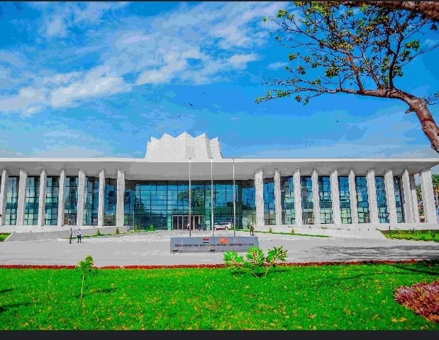
OIC CONFERENCE MAY 2024

Slide 3
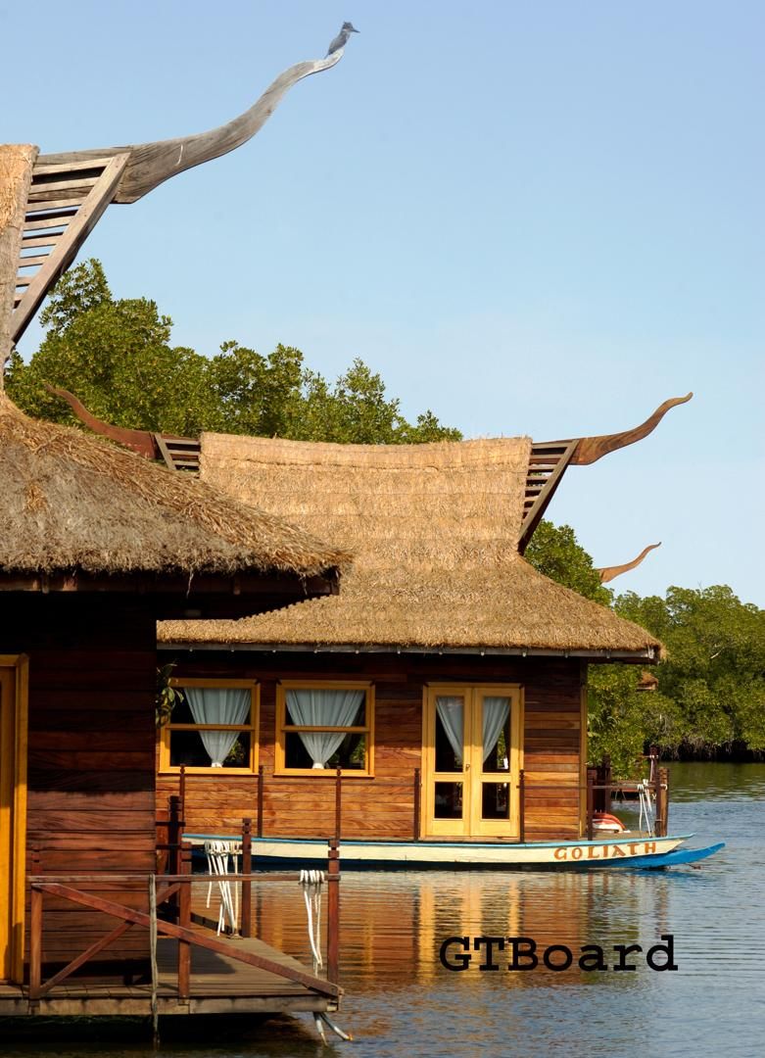
WINNER OF THE 2019 TOURISM DESTINATION OF THE YEAR
The Gambia recieved the Golden Sun Award for Tourism Destination of the Year in 2019

Slide 4


Slide 5
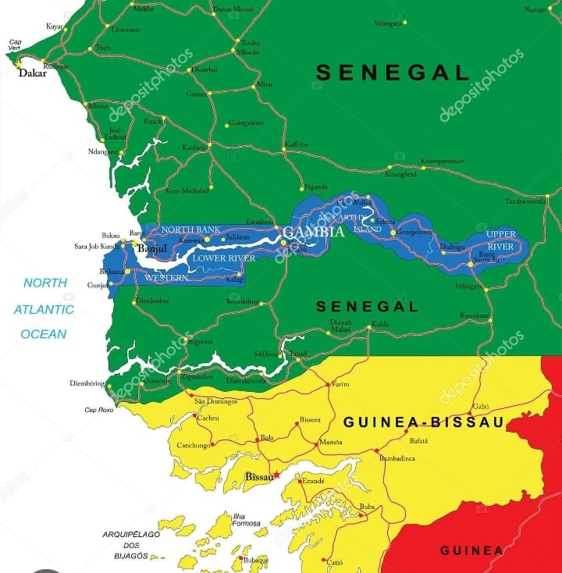

Smallest country in West Africa
Population: 2.8 million
Capital: Banjul
Currency Dalasis
Official Language: English
Size: 480km long and 25 to 30 km on either side
River Gambia is the most important Geographical feature
Multiple ethic groups
Tourism most important sector of the Economy

Slide 6
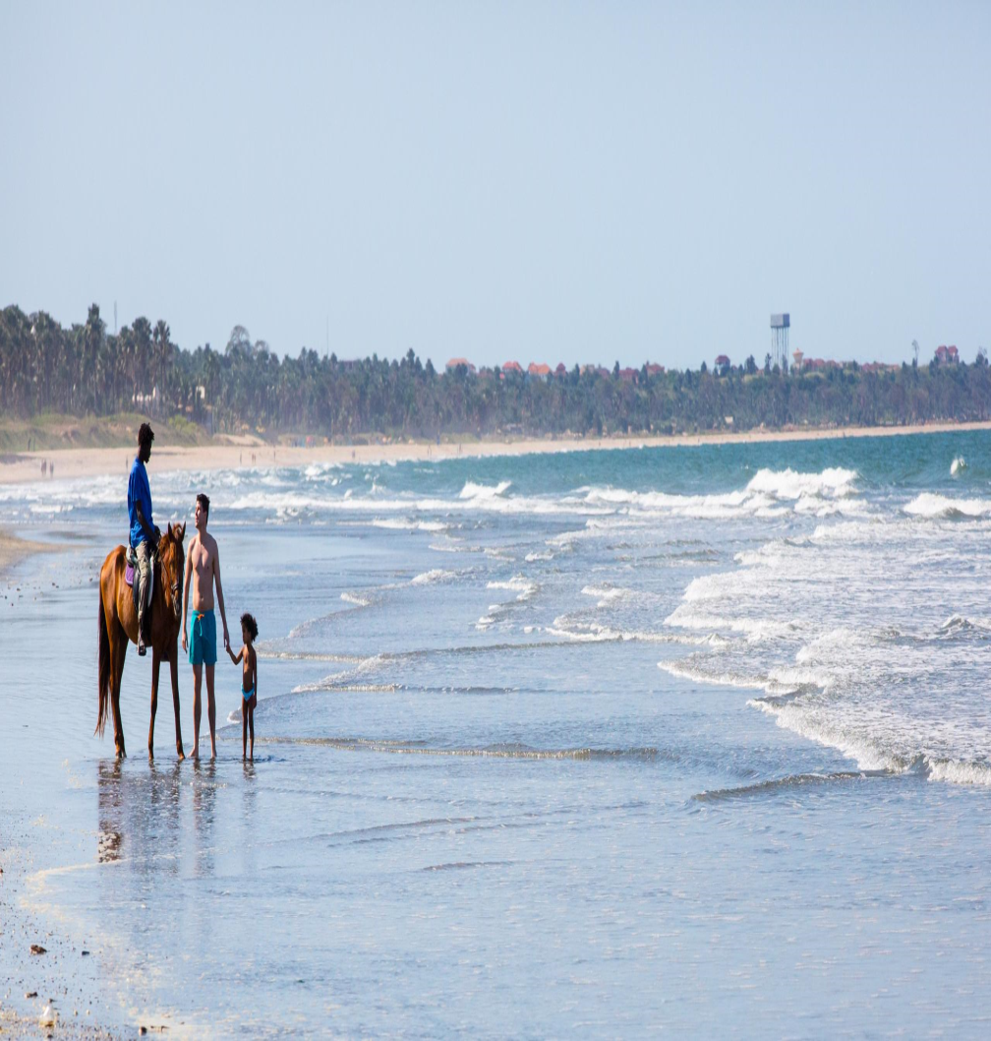
TOURISM: “THE GOOSE THAT LAYS THE EGG”
Supports 42,000 direct jobs
Indirectly supports 40,000 jobs
Generates USD 85 million in foreign exchange

Slide 7
TOURISM ARRIVALS
182,795 arrivals (78%)
British
Dutch
Spanish
Belgian

Slide 8
Main Attractions

Slide 9
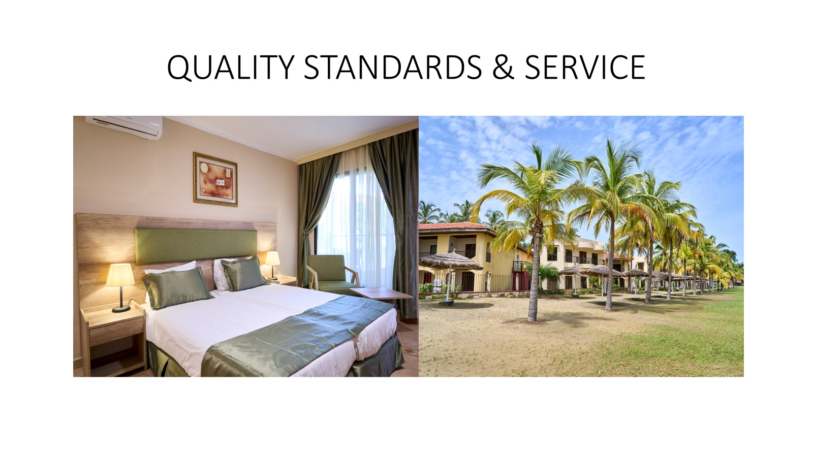

Slide 10
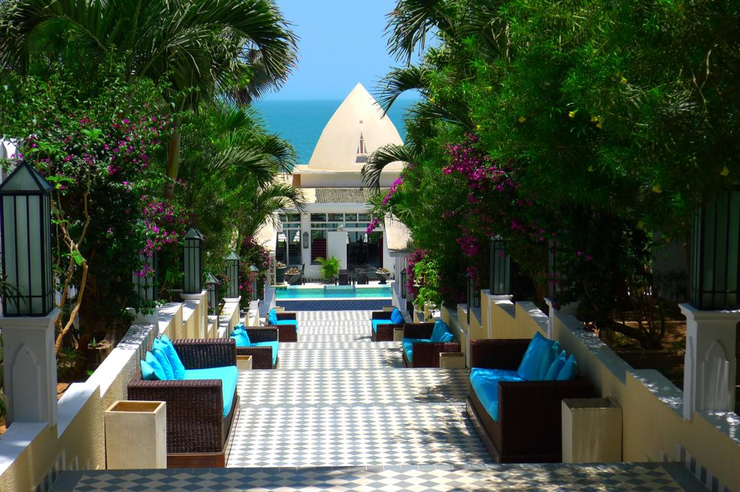

Slide 11
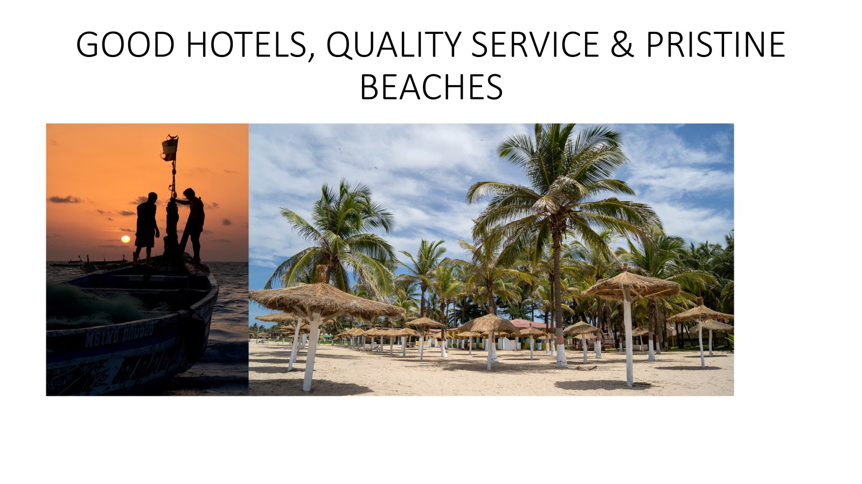

Slide 12
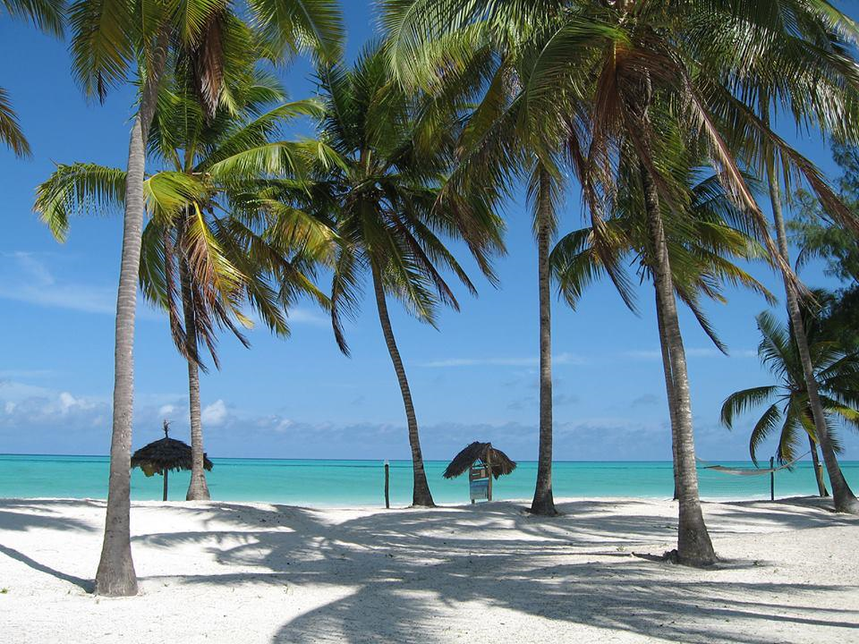

Slide 13
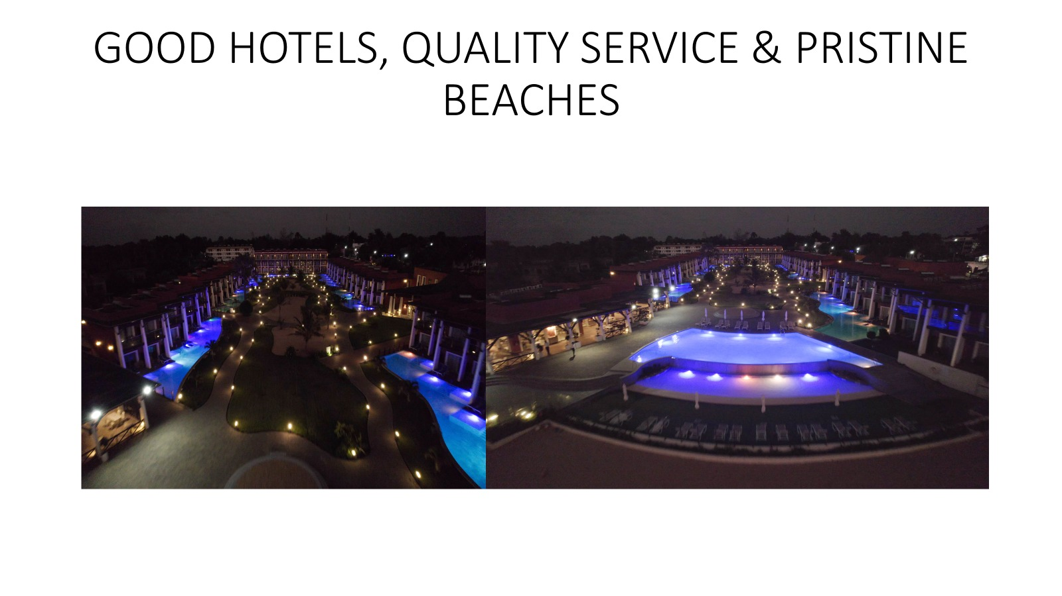

Slide 14
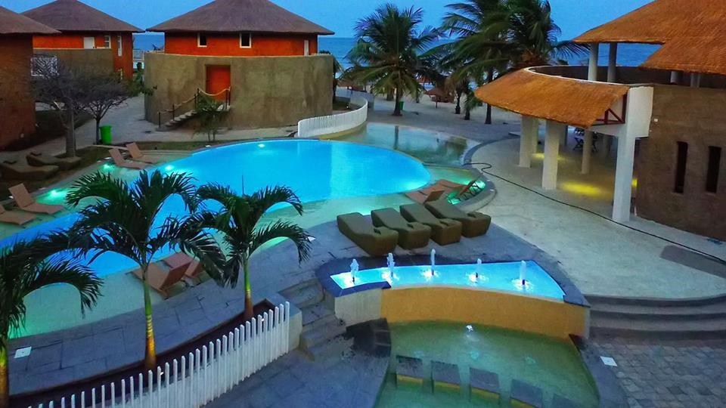

Slide 15
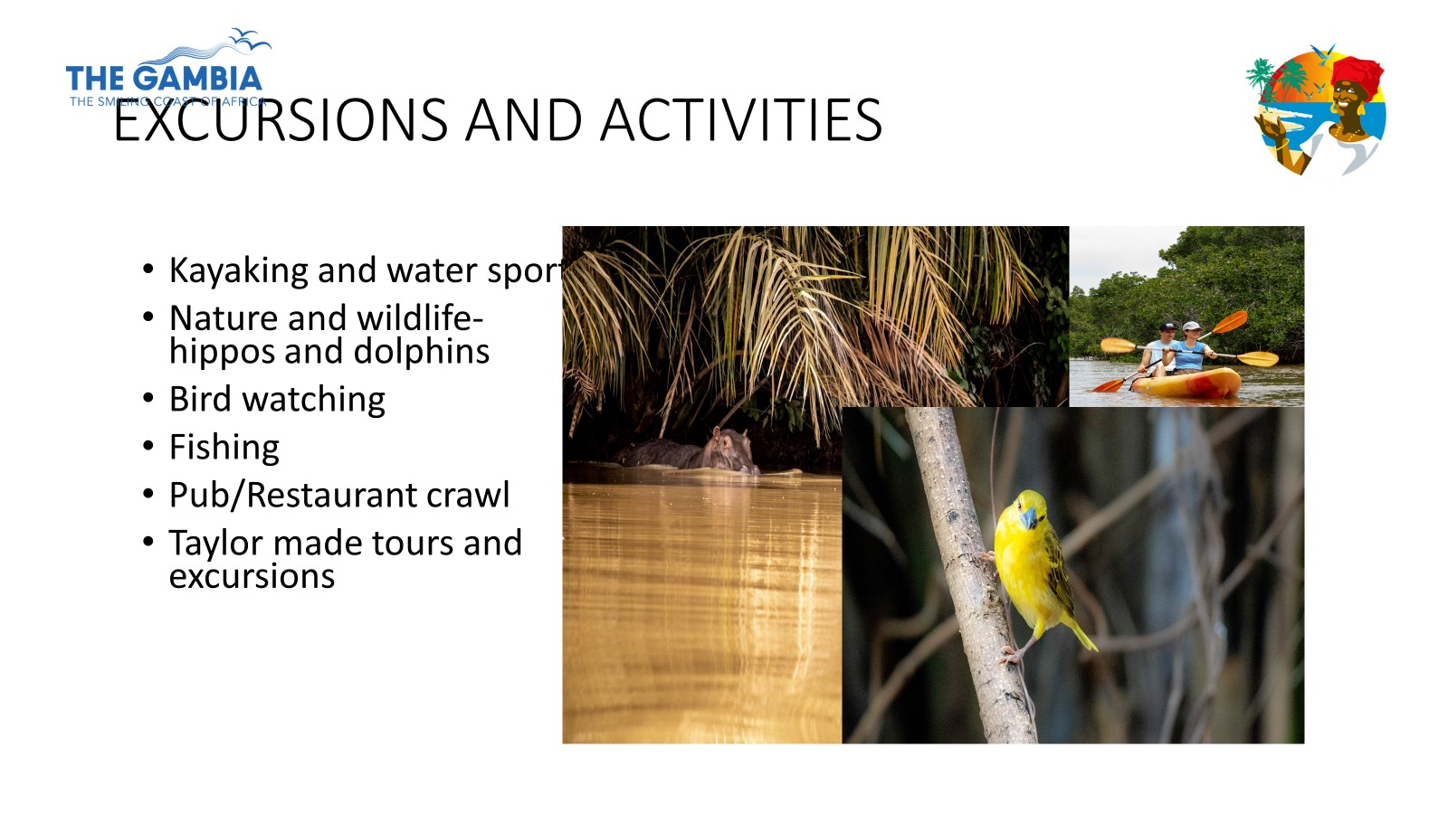

Slide 16
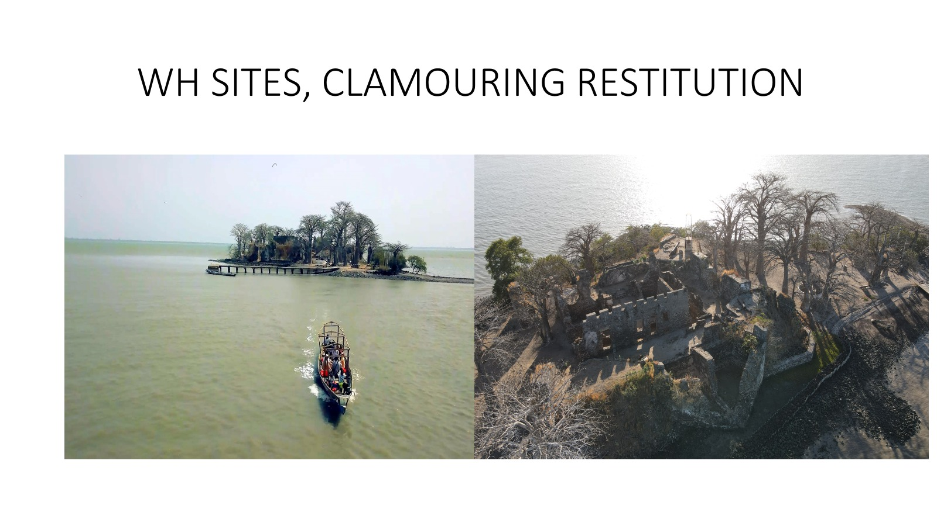

Slide 17
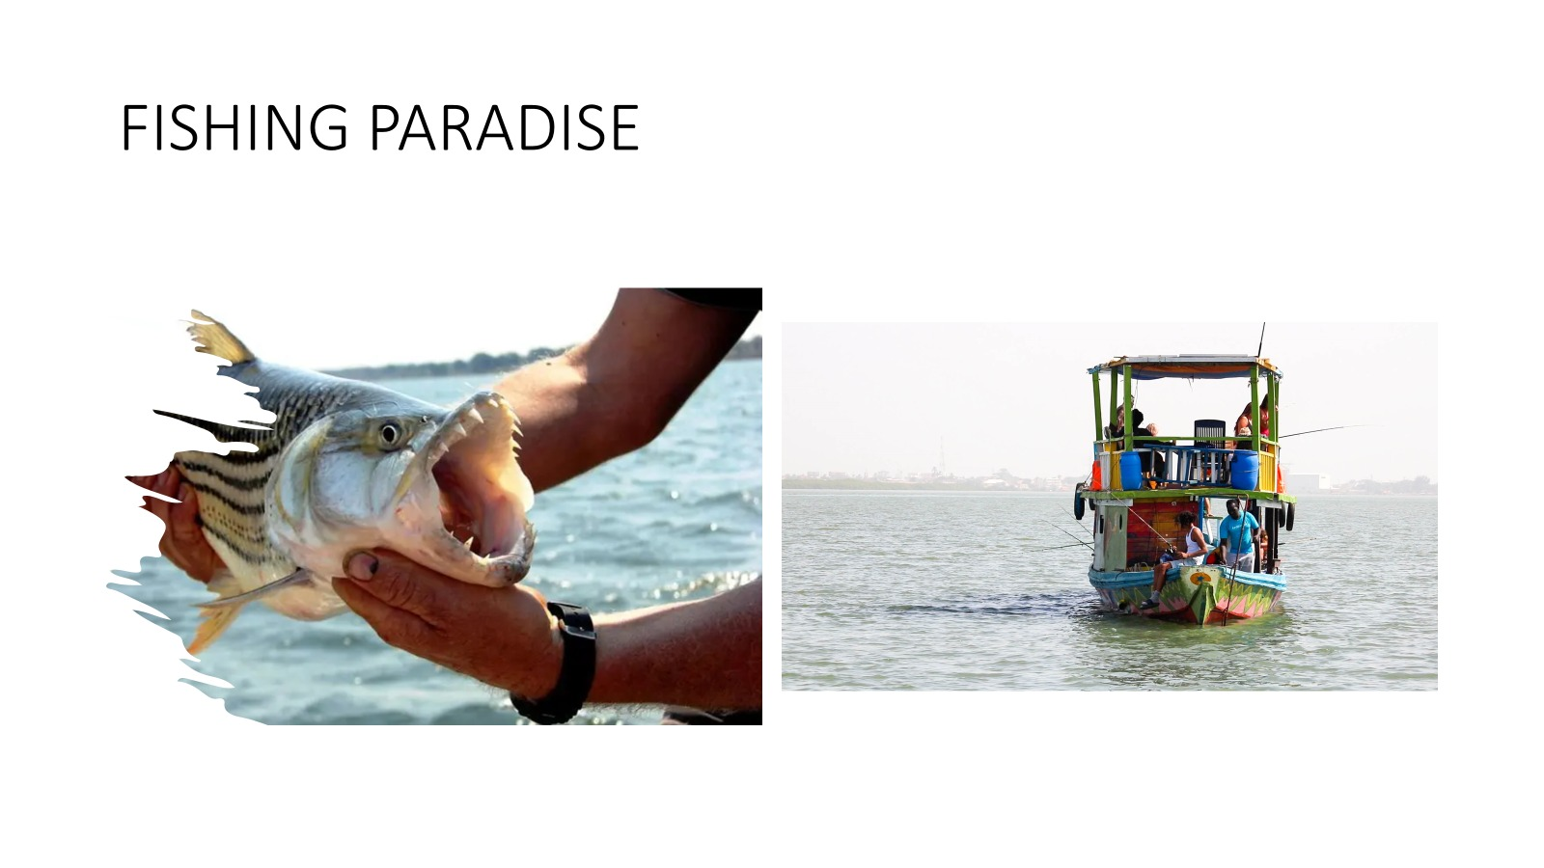

Slide 18
VISION
The Gambia with its friendly and hospitable people, unique flora and fauna and the majestic River Gambia, is a prime destination of choice for a sustainable and responsible tourism that encompasses valued experiences of natural and cultural heritage, wellness, quality products and services.

Slide 19
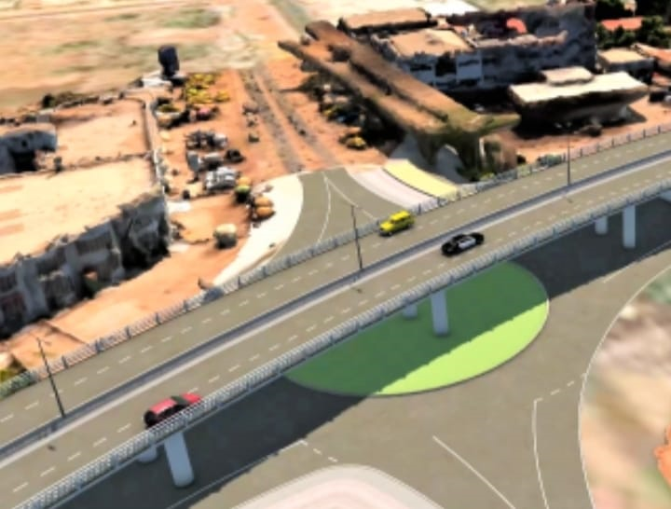
POLITICAL WILL
World Bank Project USD 68 million
Hosting of the OIC Conference
Roads
Biggest Conference Center in West Africa

Slide 20
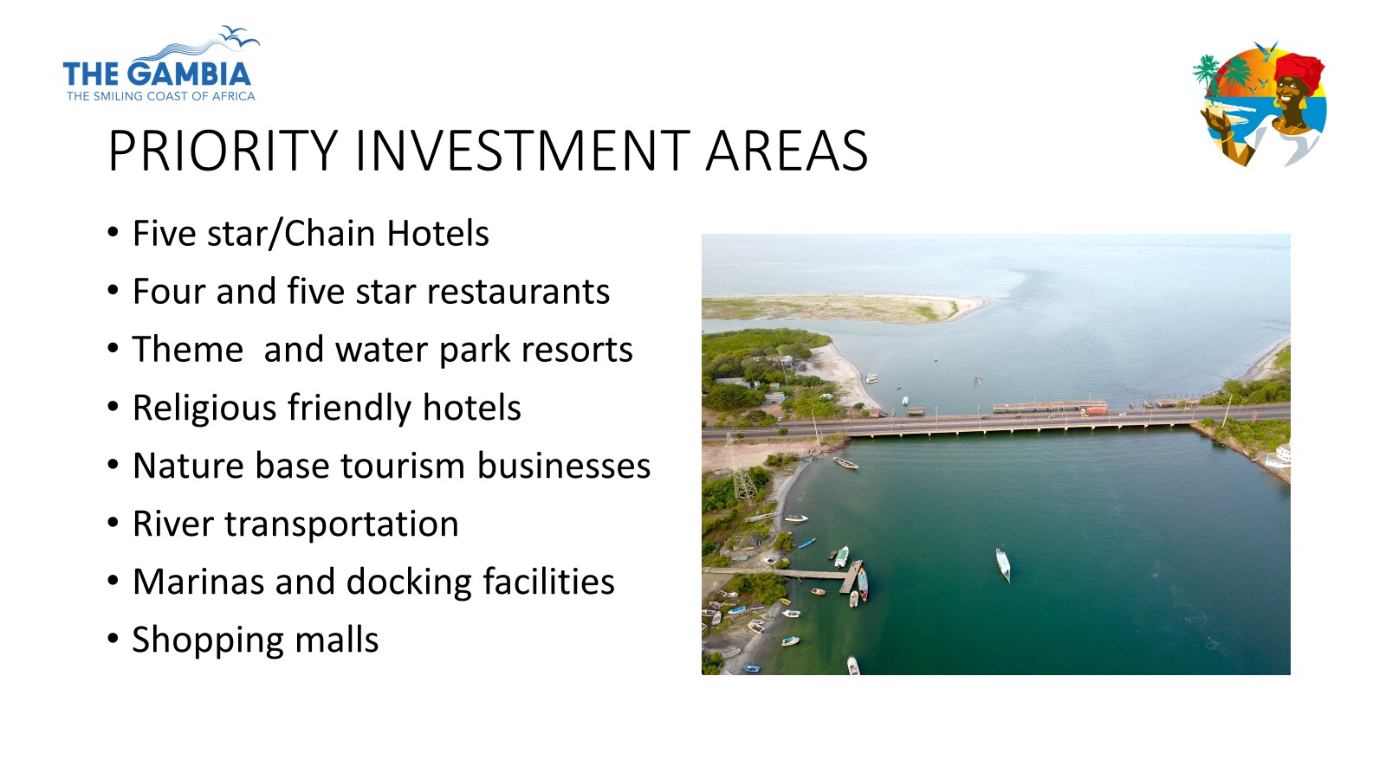

Slide 21
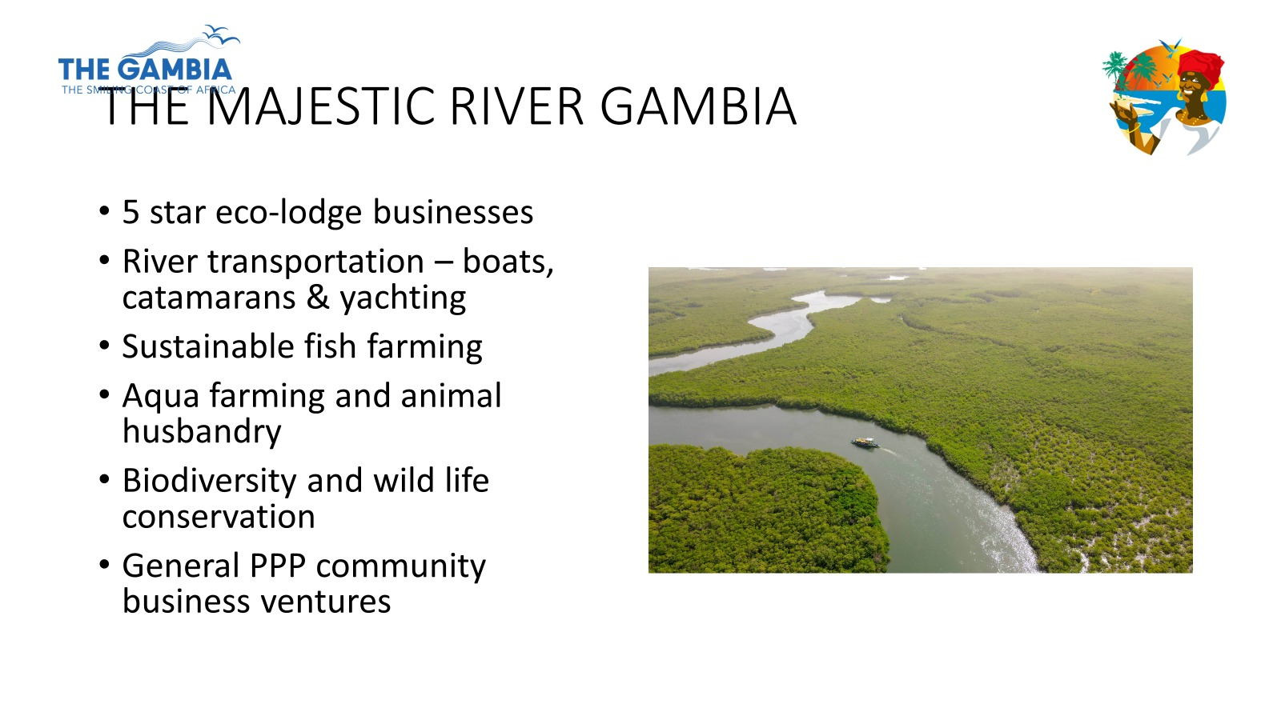

Slide 22
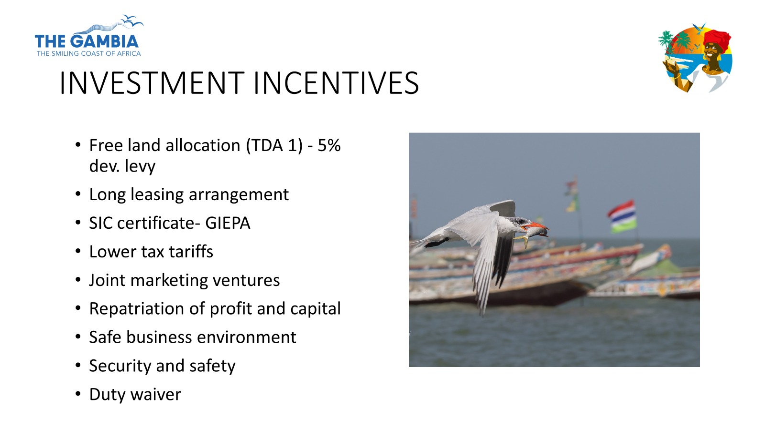

Slide 23
GROUND HANDLING AND LANDING INCENTIVES
Gambia Civil Aviation Authority
Gambia International Airlines

Slide 24
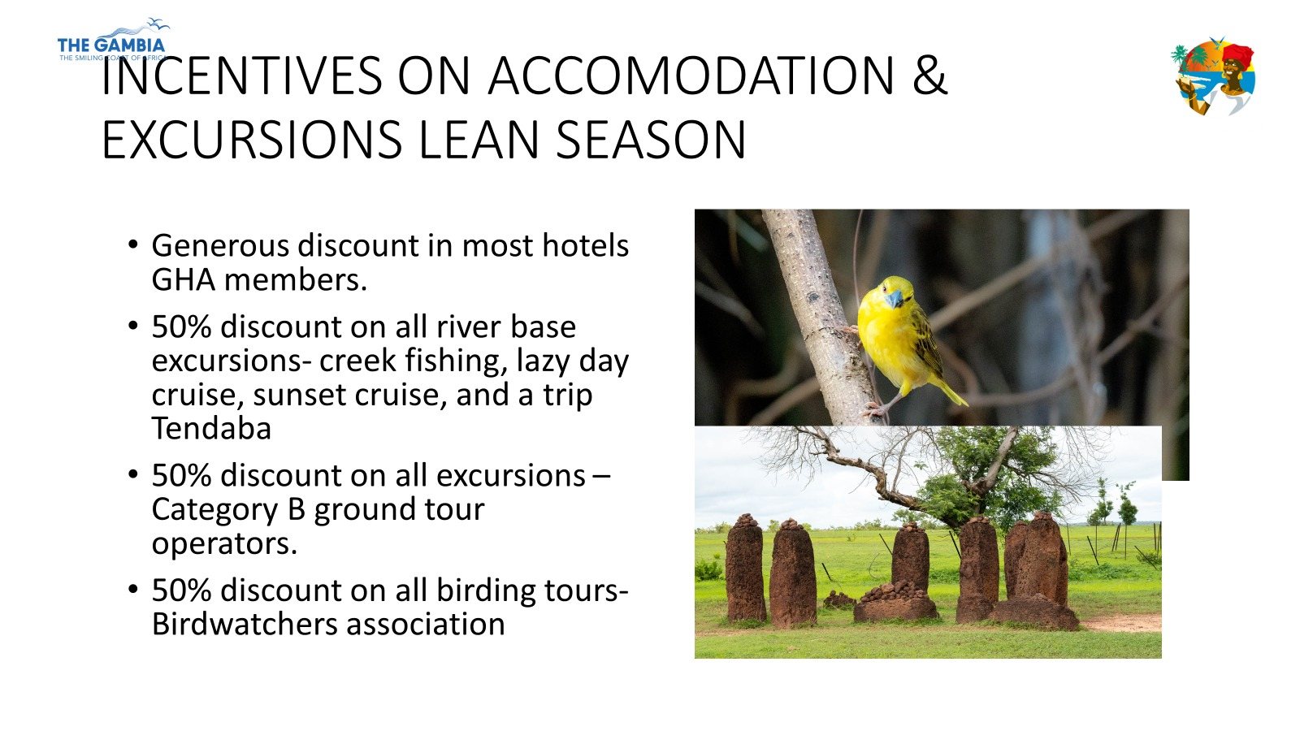

Slide 26
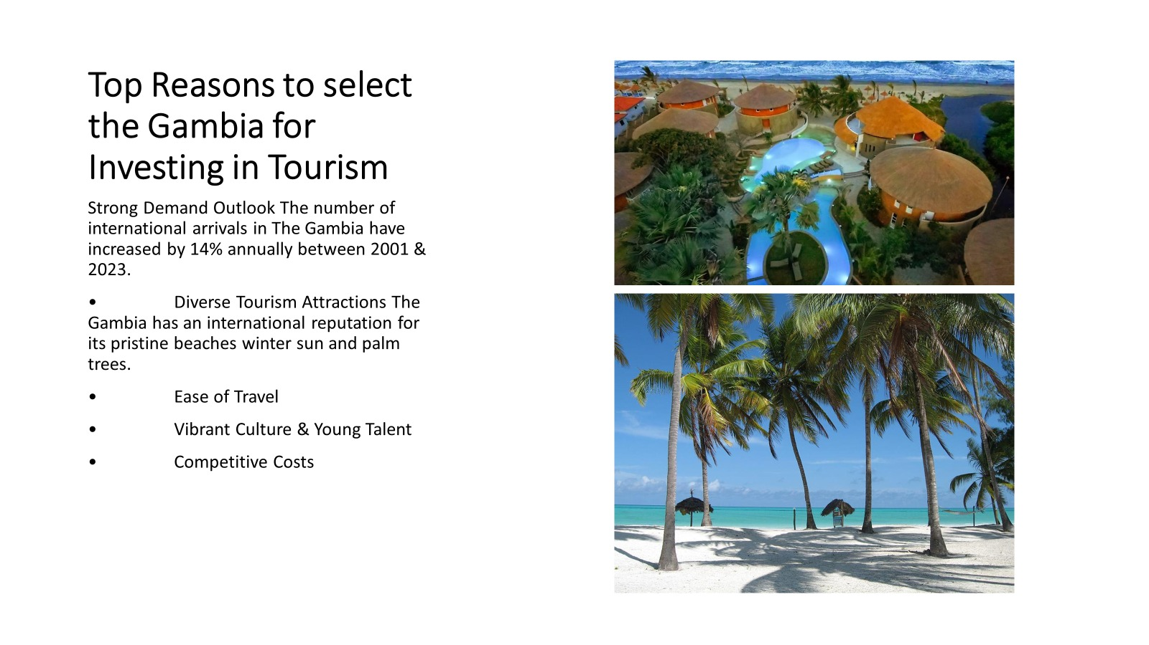

Slide 27

TOURISM DEVELOPMENT AREA
80KM COASTLINE

Slide 28
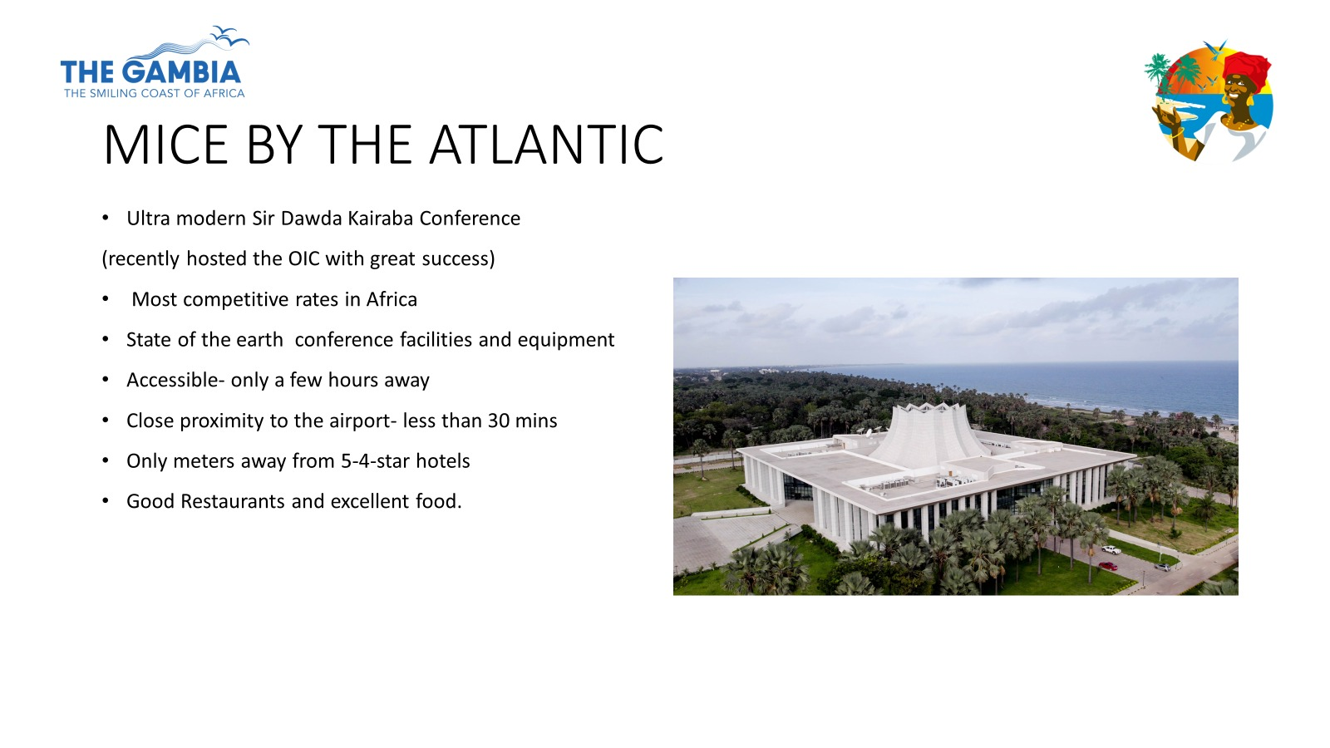

Slide 29
AIR ACCESS
Vueling
Royal Air Maroc
Turkish Airlines
TAP
SN Brusells
Potentially Binter Canarias

Slide 30
INVESTMENT OPPORTUNITIES
Hotels and other forms of accommodation
Aviation/Airlines
Tour operators
Travel Agencies
River Transport
Poultry etc
Ecotourism
ETC

Slide 31
