Slide 1
Advancing Climate Action and Sustainable Development Goals: The Transformative
Role of African Libraries and Information Centres
II Congress on “Digital Dialogues Africa–Spain. Social Sciences and Digital
Humanities”, 7–8 May 2026 Casa Africa, Las Palmas de Gran Canaria, Spain
Nerisa Jepkorir Kamar
Project Co-Ordinator Information Africa Organization (www.informationafrica.org)/
Vice Chair: IFLA Sub Saharan Africa Regional Division (2025- 2027)
Email: erisaj@gmail.com/ nerisa@informationafrica.org

Slide 2


Introduction
Climate Action
Libraries as knowledge hubs in Africa
Importance of climate action for sustainable development
Alignment with SDGs, Agenda 2063& WSIS Action
Notes:
As universities look to address the issues of new pedagogies, changing technology and new generation of students, space plays a key role (Steelcase, 2010)

Slide 3
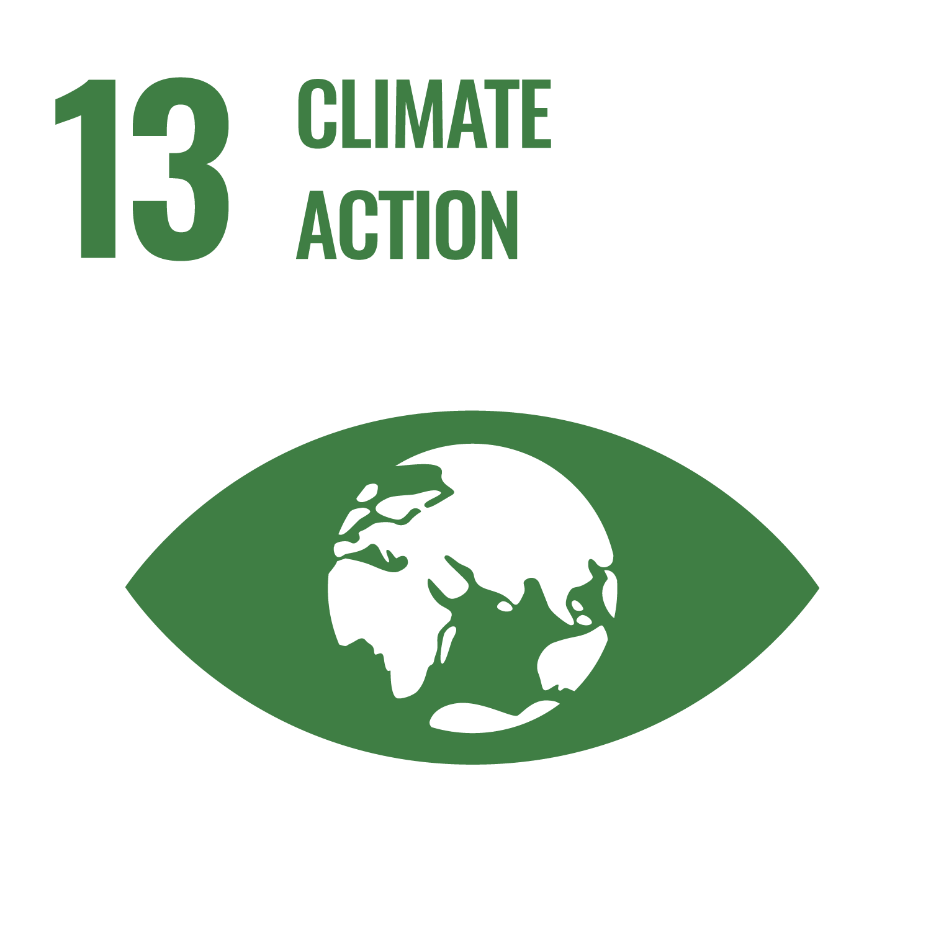



Climate Action & SDGs Overview for libraries
Climate Action SDG 13
Cross-cutting relevance of libraries to other SDGs ( 4, 11, 17)
Libraries as enablers of community resilience and knowledge equity

Slide 4
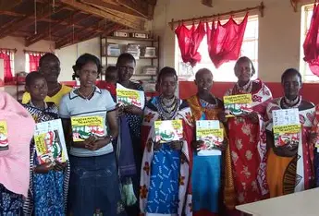
The Transformative Role of Libraries
Access to Information: Climate data, research, indigenous knowledge
Capacity Building: Training communities on sustainability practices
Advocacy & Awareness: Campaigns exhibitions, dialogues
Innovation Spaces: Makerspaces, digital labs for green solutions
Notes:
As universities look to address the issues of new pedagogies, changing technology and new generation of students, space plays a key role (Steelcase, 2010)

Slide 5
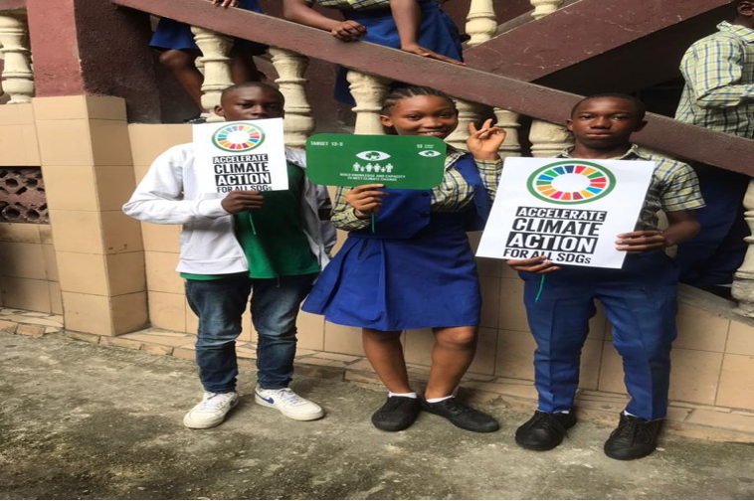
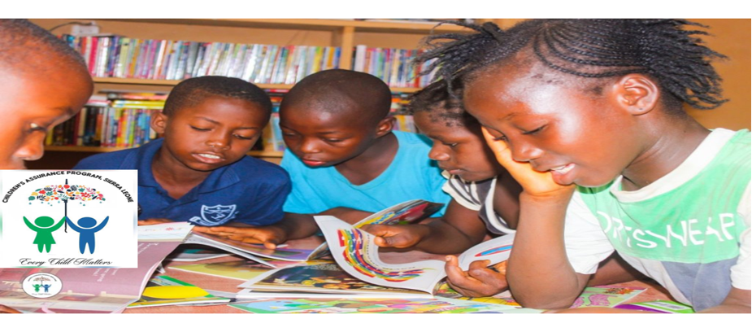
African Context
Libraries as community anchors in rural and urban Africa
Integration of traditional knowledge with modern science
Partnerships with governments, NGOs, and universities
Case studies/Examples:.
Kenya National Library Service (KNLS) hosting climate literacy forums/corners, e-motorcycle battery swapping stations
South Africa’s community libraries- repair cafe,Public Earth Observatories
Sierra Leone Climate Assuarence library program
Notes:
to establish electric motorcycle battery swapping stations at various library branches to support sustainable urban mobility.

Slide 6


Green Library Infrastructure
Energy-efficient buildings, solar panels, rainwater harvesting.
Libraries model sustainability for communities.
Examples:
University of Dar es Salaam Library(Tanzania) uses solar energy.
Stellenbosch University Library (South Africa) recycling initiatives- three-bin sorting system, installation of water-saving devices, grey water systems, water-wise
landscaping- (in line with university's Environmental Sustainability Plan guides) + Stellenbosch communty Rycling project
Aga- Khan Univeristy library (Kenya )- energy-efficient design, eco-friendly policies, and awareness programs

Slide 7


Digital Transformation for Sustainability
Digitization reduces paper use.
E-resources minimize environmental impact.
Examples:
African Digital Library Project (Pan-African, 1999) that support ongoing activities in integrating online full e-textbooks through The Coalition on Media and Education for DevelopmentAfrica Forum (CAFOR) - University of Nairobi Library (Kenya),University of Ghana Library System, National Library of South Africa, Makerere University Library, University of Dar es Salaam Library. .
Makerere University Library (Uganda) digitizing theses.

Slide 8

Digital Transformation for Sustainability... Practical Contributions
Knowledge Management: Climate repositories, open access platforms
Digital Transformation: E-libraries, mobile apps for climate literacy
Community Engagement: Storytelling, cultural preservation linked to environment
PolicySupport:Evidence-based resources for decision-makers

Slide 9
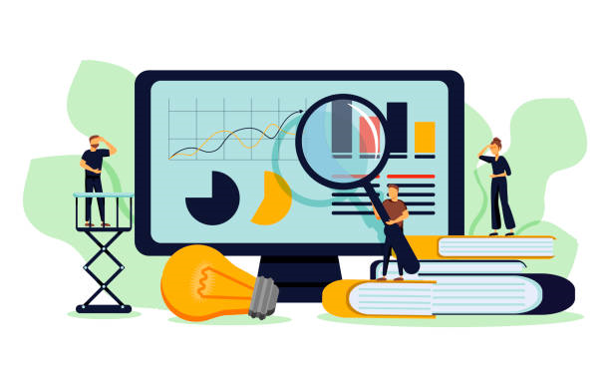

Global Alignment
Libraries advancing SDGs 2, 4, 9, 11, 13, 17
Contribution to AU Agenda 2063 aspirations
Role in WSIS Action Lines: ICT for sustainable development

Slide 10
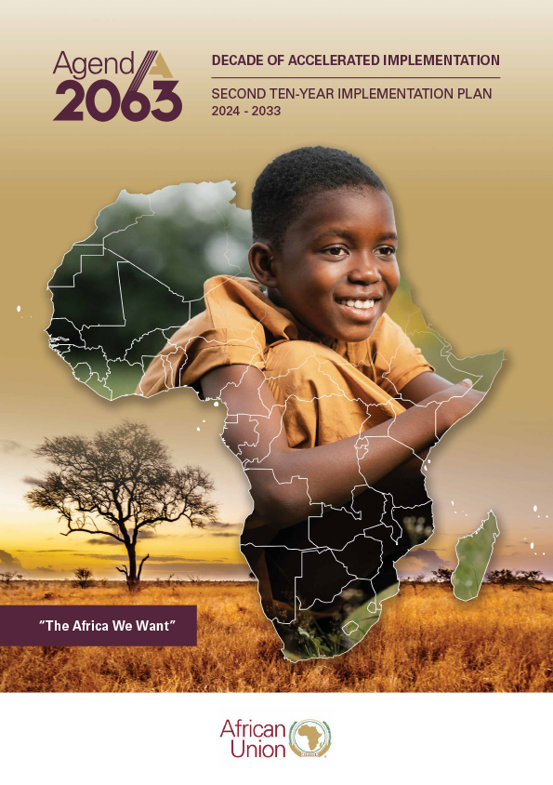
ii. Contribution to AU Agenda 2063 aspirations
The African Union's Agenda 2063 aims to achieve inclusive and sustainable development across Africa.
Role of Libraries - provide access to information and resources that support the realization of these aspirations
They contribute to climate action by promoting sustainable practices, such as climate-resilient agriculture and renewable energy transition, and by integrating climate risk management into national policies.
Libraries - facilitate the dissemination of information on climate change and the implementation of climate-resilient strategies

Slide 11

ii. Contribution to AU Agenda 2063 aspirations...
Contributions
AU Agenda 2063’s aspirations on prosperity, education, cultural identity, and people-driven development provide a strong framework for libraries to advance climate action.
African libraries are already implementing solar energy, climate literacy, indigenous knowledge preservation, and youth-led environmental programs showing how knowledge institutions can be catalysts for sustainable futures.
Examples
A1- Promotes libraries as hubs for education, innovation, and access to information- e.g. Kenya National Library Service integrates solar energy and ICT hubs to reduce carbon footprint
A2- Libraries provide lifelong learning, digital literacy, and STEM resources - e.g. Ghana’s public libraries run climate literacy programs for youth, linking SDGs with local action.

Slide 12
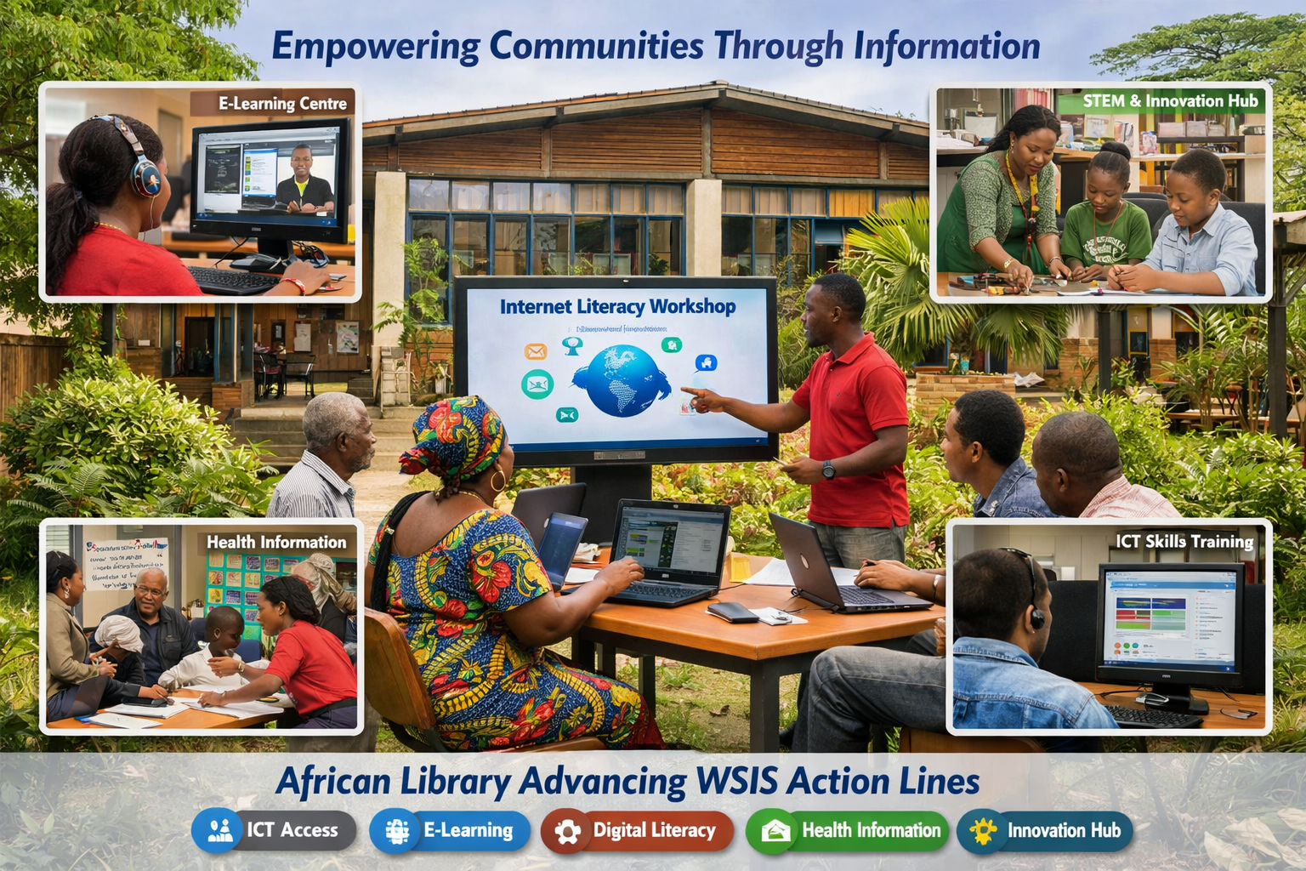
iii. Role in World Summit on the Information Society (WSIS) Action Lines: ICT for sustainable development
WSIS Action lines for libraries :
Access to Information and Knowledge - inclusive hubs that bridge the digital divide, equitable access to ICT tools, digital resources, and knowledge.
Capacity Building and Digital Literacy- empower citizens with digital skill; drive innovation and inclusive participation in the knowledge economy; advance the SDGs and AU Agenda 2063.
Community Development and Sustainability -integrate ICT into local development initiatives supporting education, agriculture, health, and entrepreneurship= contribution to sustainable socio-economic growth.

Slide 13
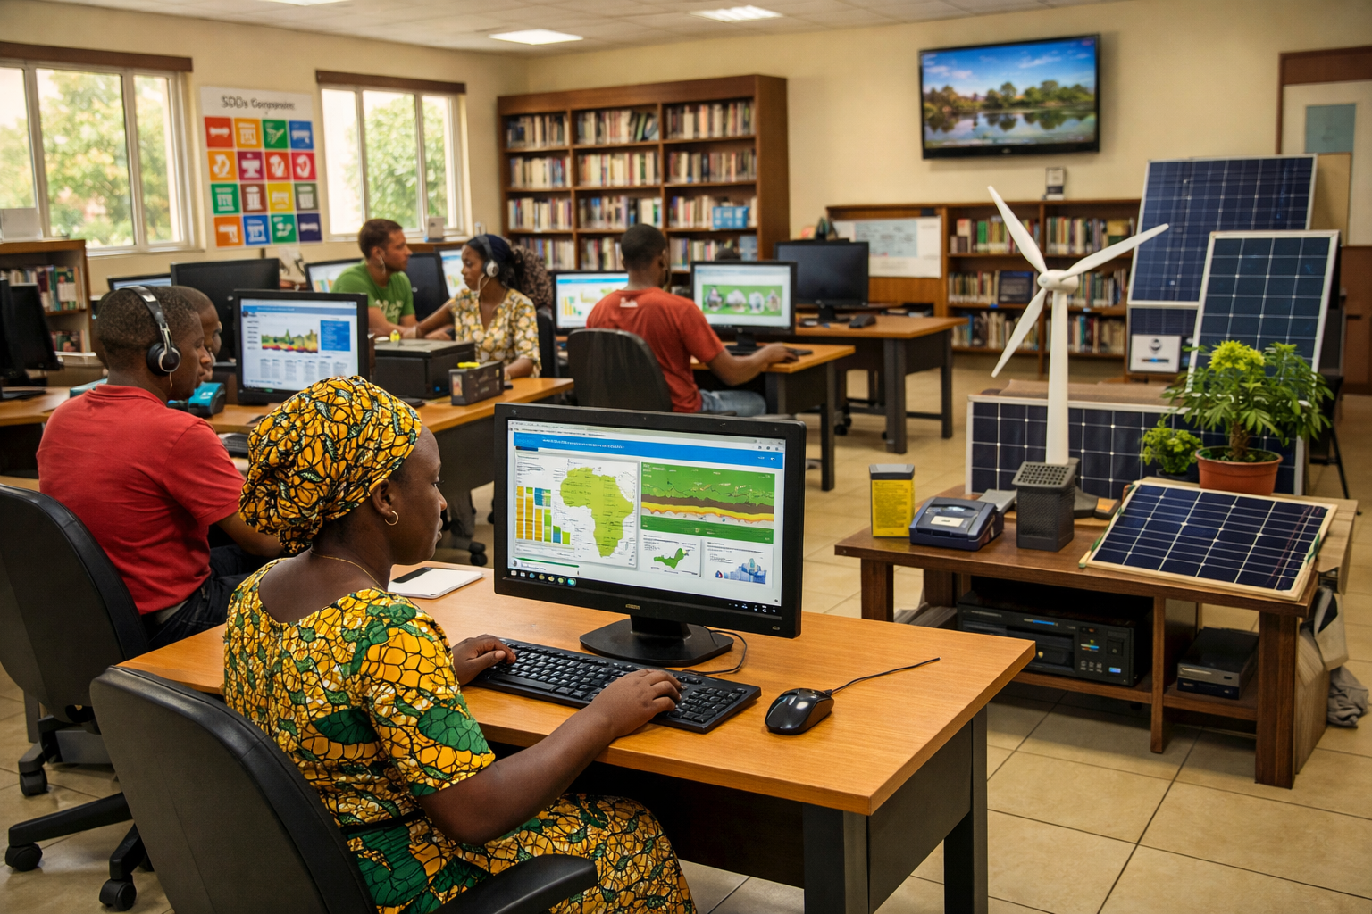
iii. Role in World Summit on the Information Society (WSIS) Action Lines: ICT for sustainable development….
iv. Preservation of Indigenous Knowledge - safeguard indigenous knowledge systems through digitization and dissemination of cultural heritage; global access = strengthening Africa’s voice in international knowledge networks.
v. Partnerships and Policy Influence - collaborate with governments, NGOs, and international bodies to shape ICT policies, advocate for open access, and align national strategies with WSIS Action Lines.
vi. Innovation and Research Support- provide ICT-enabled platforms for research, data management, and innovation, reinforcing Africa’s role in global knowledge production and sustainable development.
.

Slide 14
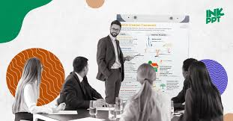
Impact Measurement Indicators:
To capture the breadth and depth of climate-related initiatives, by highlights both quantitative and qualitative indicators of success.
Number of climate-related programs hosted - Demonstrates institutional commitment and scope of climate action.
Community participation levels - Reflects inclusivity, engagement, and ownership of initiatives.
Partnerships formed - Highlights collaboration, resource mobilization, and strengthened networks.
Digital resource usage statistics -Shows integration of technology, accessibility, and reach of climate knowledge (awareness and action).
Qualitative impact (empowerment, awareness, resilience): - Captures transformative outcomes beyond numbers, emphasizing strengthened capacity and adaptive communities.

Slide 15
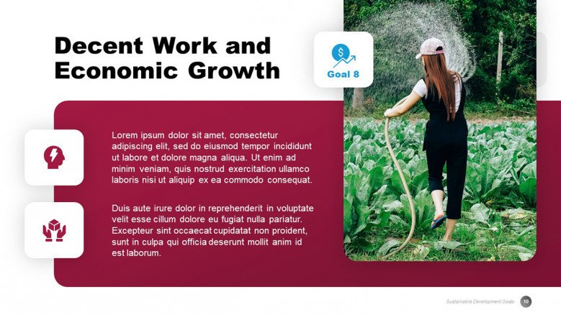
Opportunities
Expanding digital access- increase e-learning modules, open data repositories, and interactive tools on climate knowledge resources - challenges , innovations and solutions . It bridges the urban–rural divide
Strengthening partnerships- for collaborations enable resource sharing, joint programming, and policy advocacy (governments, academia, NGOs, private sector etc). Create networks of practice that scale local initiatives into regional and continental movements, aligning with both the SDGs and AU Agenda 2063.
Develop an easily applicable Climate Action Framework for Libraries in Africa (AFLIA, SCESCAL, Africa library consortiums, Information Africa Organization…)
Leveraging indigenous knowledge-documentation, preservation, and dissemination of IKS that embody sustainable practices. i.e.
    Integrate traditional ecological wisdom with modern science for culturally grounded climate solutions.
    Strengthen community resilience
    validate the role of indigenous voices in shaping Africa’s climate future.

Slide 16
Opportunities...
Leveraging on existing infrastructure at international, regional, national, and institutional levels
  IFLA: i )The IFLA Environment, Sustainability and Libraries (ENSULIB) Section proudly announces the publication of the IFLA Guidelines for Green Libraries ii) IFLA’s Climate Action Commitment ahead of COP26 climate summit, 17 September, 2021
  IFLA - SAA RDC with a strong action plan on Climate Led Library Projects (2025-2027)
  SSA RDC 2023 strategy focuses on integrating climate action into library and information services
  Conferences/seminars
    Africa Climate Summit, Addis Ababa , September 2025 with Climate Heritage Network
  Webinars
    Libraries at the Frontlines of Climate Action By Dr. Buhle. Nov. 2025
    Building Sustainable Library Systems through Partnerships, Advocacy, and Community Empowerment by Damilare January 2026,
    Transforming Libraries from Quiet Repositories of Books into Active Climate Futures Labs by Climate Heritage Network, 30th April 2026.

Slide 17
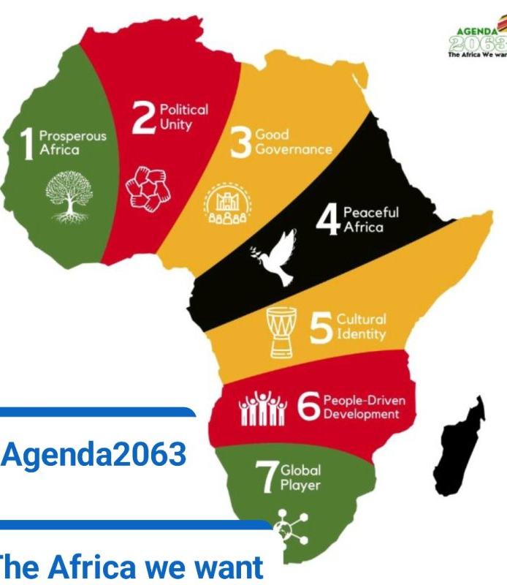
Challenges
Funding gaps
Limited budgets: constrained financial allocations results to
prioritized basic services rather than climate-focused initiatives
Dependence on external donors: Reliance on international grants can create instability, as funding cycles are short-term and not always aligned with local priorities
Missed opportunities: Without adequate funding, libraries struggle
to invest in climate literacy programs, digital platforms, and community outreach that could empower citizens to act on SDGs
Equity concerns: Rural and marginalized communities are disproportionately affected, as their libraries often receive the least
support, widening the knowledge divide on climate resilience.

Slide 18
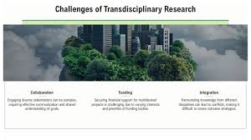
Challenges...
Digital divide: lack of reliable internet& modern ICT tool; lack of renewable energy sources; limiting their ability to provide climate data, e-learning, and global knowledge exchange.
Physical facilities: Ageing buildings, poor maintenance, and inadequate space hinder the hosting of workshops, exhibitions, or innovation hubs focused on sustainability.
Resource scarcity: Limited access to climate-related publications, databases, and multimedia tools restricts libraries from becoming true knowledge centres for climate action.
Resilience gaps: Librarie vulnerability to climate impacts (floods, droughts, heatwaves), with no disaster-preparedness infrastructure or green building designs.

Slide 19
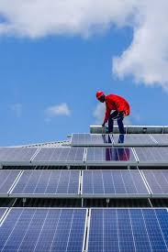
Need for Policy Recognition
Libraires are under represented in national climate strategies and SDG frameworks, despite their potential as community anchors for education and advocacy.
lack of policy documentations on integration of libraries as partners in climate action thus missing out on funds, strategic partnerships etc
Advocacy challenge: need for Library leaders to continuously demonstrate their relevance to policymakers and their role as dynamic knowledge hubs.
Global alignment: though libraries struggle to connect local initiatives to continental frameworks (AU Agenda 2063) and global ones (WSIS, SDGs), they are rarely recognised, limiting their transformative impact.

Slide 20

Conclusion
Libraries are more than repositories of knowledge they are active agents of change in Africa’s climate action journey.
By aligning their strategies with the aspirations of the African Union’s Agenda 2063, libraries can play a transformative role in advancing sustainable development, safeguarding indigenous knowledge, and empowering communities..
Solar-powered technologies, climate literacy programs, youth-led initiatives, and the preservation of cultural archives demonstrate that libraries are already playing a significant role in shaping a greener and more sustainable future
A replicable framework enables scalability, allowing every library to contribute effectively to Agenda 2063 and SDG 13.
Thus, libraries can decisively position themselves as knowledge hubs, cultural custodians, and frontline leaders in climate action, powerfully advancing Africa’s vision of prosperity, resilience, and global influence.

Slide 21
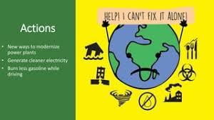
Call to Action
Invest in libraries as climate knowledge hubs
Strengthen partnerships with global and local actors
Empower communities through inclusive access to information
Position African libraries as drivers of sustainable futures- through strategic polices
Need to prioritizing energy efficiency, renewable energy, green cleaning, recycling, indoor air quality, and green spaces in libraries
Replicate best practices and success stories

Slide 22
References
The National Climate Action Strategy for Libraries Implementation Guide (NCASL) by The Sustainable Libraries Initiative (SLI) and the American Library Association (ALA), 2023. Available https://www.sustainablelibrariesinitiative.org/media/document/614
IFLA Guidelines for Green Libraries by IFLA Environment, Sustainability and Libraries (ENSULIB) Section, 2026. Available https://repository.ifla.org/rest/api/core/bitstreams/9b71fdb8-0d95-492a-8236-dab027791382/content
Partnership Launches Ambitious Rooftop Solar Power Project at UDSM, by Renancy Remmy, CMU, 2025. Available https://www.udsm.ac.tz/news/partnership-launches-ambitious-rooftop-solar-power-project-udsm

Slide 23

Kongoi missing!
ASANtE SANA!
Thank you!!

