Slide 1

Large Language Models &
Black Female
Epistemic Exclusion
& the Need for Leadership from Africa
Mutale Nkonde, University of Cambridge
CASA Africa 2026

Slide 2
My 2023 Prompt
What is the relationship between Bessie Smith and Mahalia Jackson?
CASA Africa 2026

Slide 3
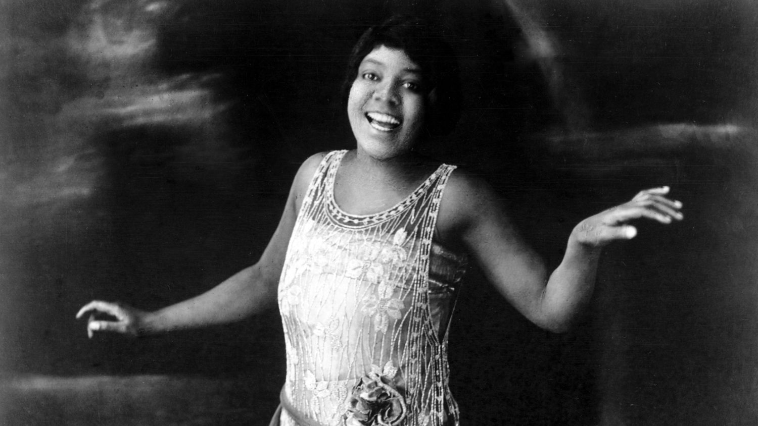
Who is Bessie Smith?
One of the first successful artists for Apollo Records during the 1940’s
First Black Female Popular Star
Foundational to the understanding of “race music”
Empress of the Blues
CASA Africa 2026

Slide 4
The Response
ChatGPT 3 (2023)
Could not offer a response just two different profiles
Chat GPT 5.6 (2026)
Talked about their contributions but not their shared lineage within the race music tradition
CASA Africa 2026

Slide 5
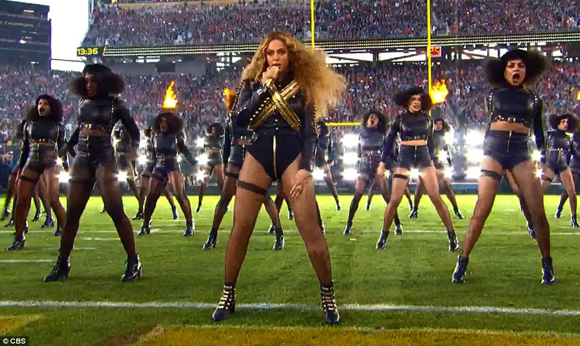
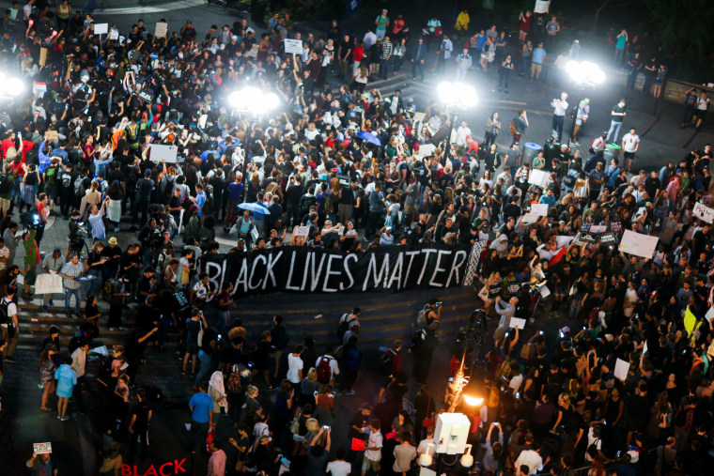
Bessie Smith’s Influence on Modern Music
Beyonce Superbowl 2016
During the Rise of #BlackLivesMatter
CASA Africa 2026

Slide 6

Over 15 Years of Academic Work at the Intersection of Race, Gender and Technology
CASA Africa 2026

Slide 7

What This Says About LLMs and Race and Gender
Epistemic Exclusion
Element of African exclusion
CASA Africa 2026

Slide 8



The Problem …. Support for Eugenics in Silicon Valley
Should we focus on racism in LLMs?
CASA Africa 2026

Slide 9
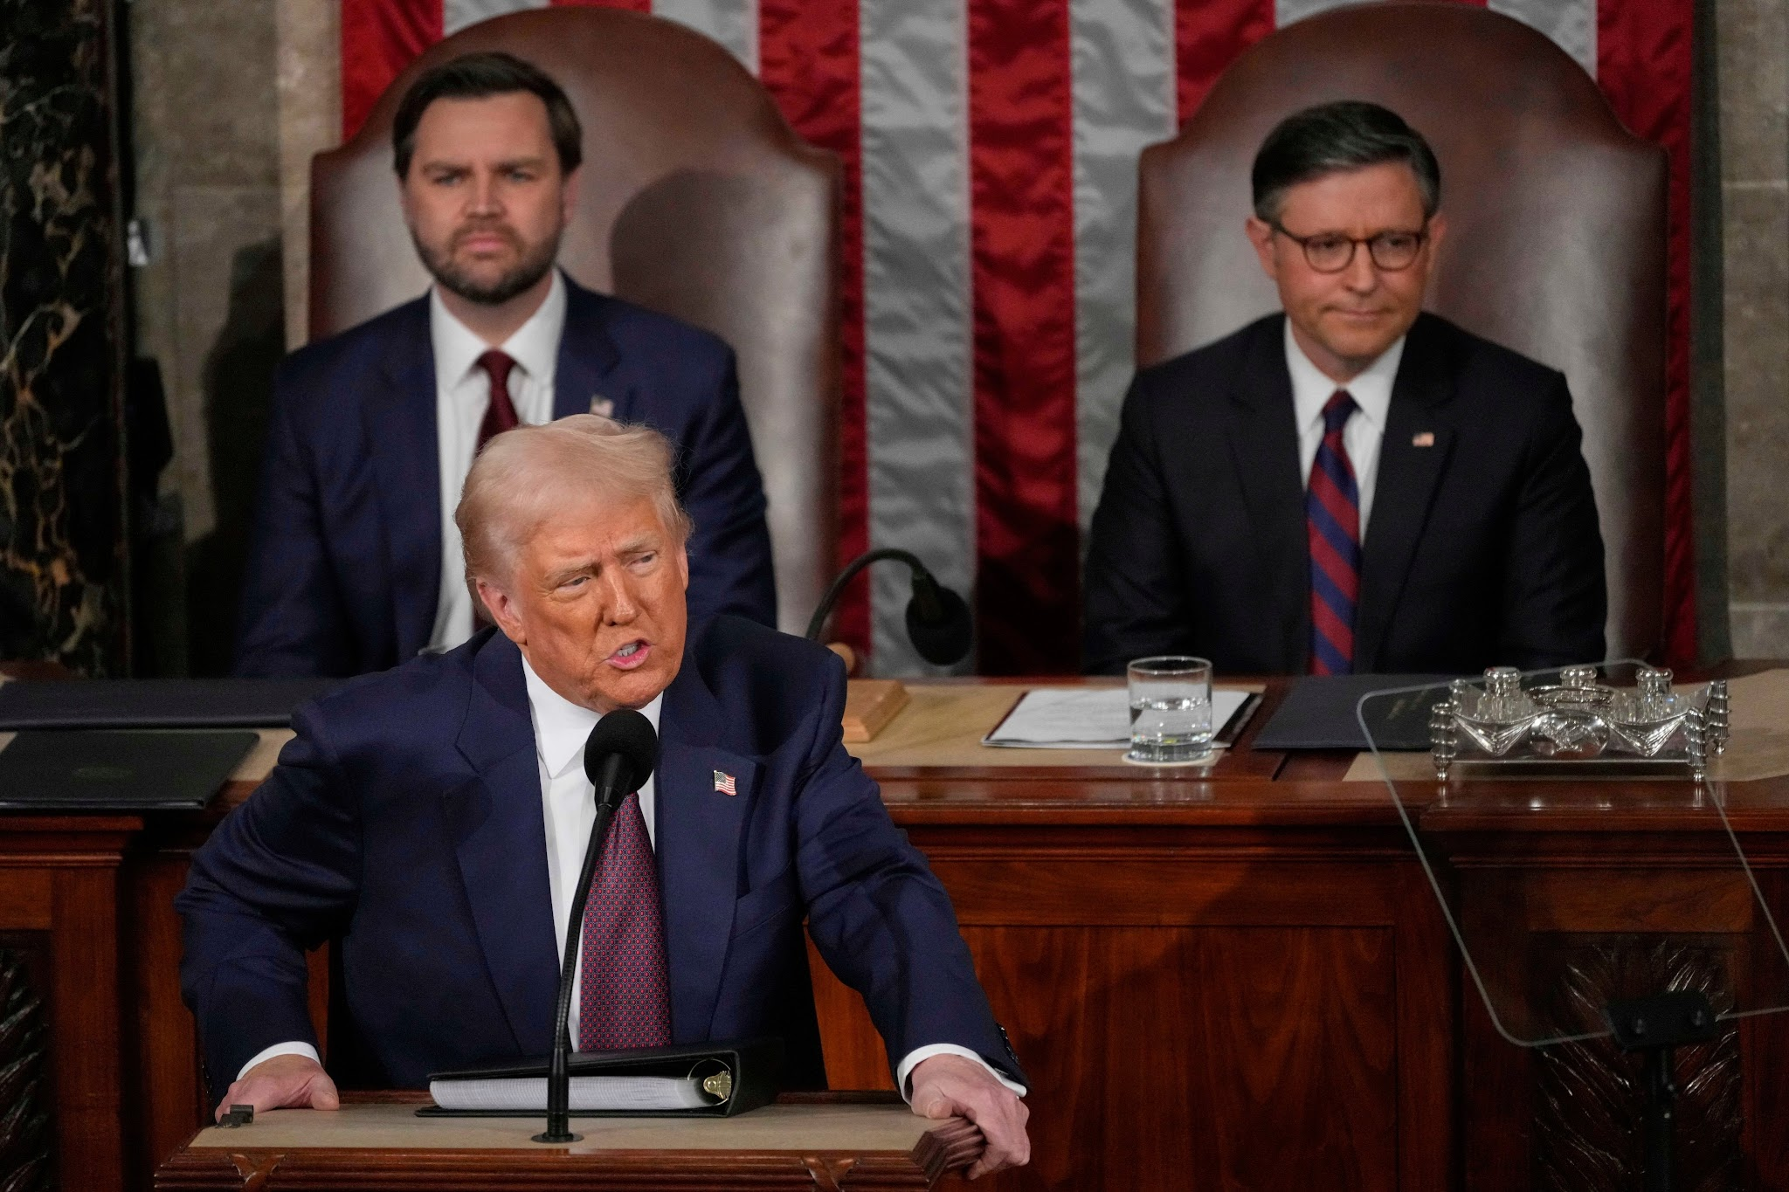

No Political Will
CASA Africa 2026

