Slide 1
Empowering Librarians to Lead Digital Inclusion in Africa: Insights from Library Aid Africa
Damilare Oyedele
Co-Founder & Chief Executive, Library Aid Africa

Slide 2

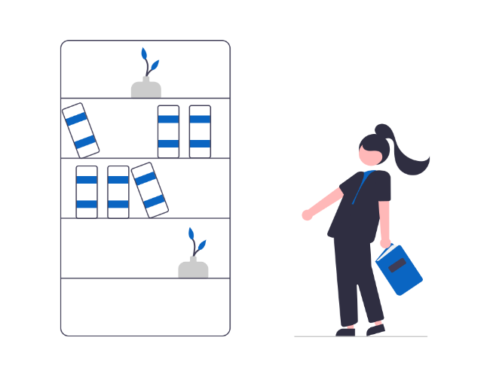




Slide 3
Capacity Development
Library Tech Solutions
Library Policy Advisory
Library Programing and Infrastructure Support

Slide 4



ACHIEVEMENTS
Partners across
Impact across
6
9
22
Years
African Countries
African Countries

Slide 5
Empowering Librarians to Lead Digital Inclusion in Africa: Insights from Library Aid Africa

Slide 6

HOW?

Slide 7

Empower Librarians to lead digital inclusion efforts

Slide 8

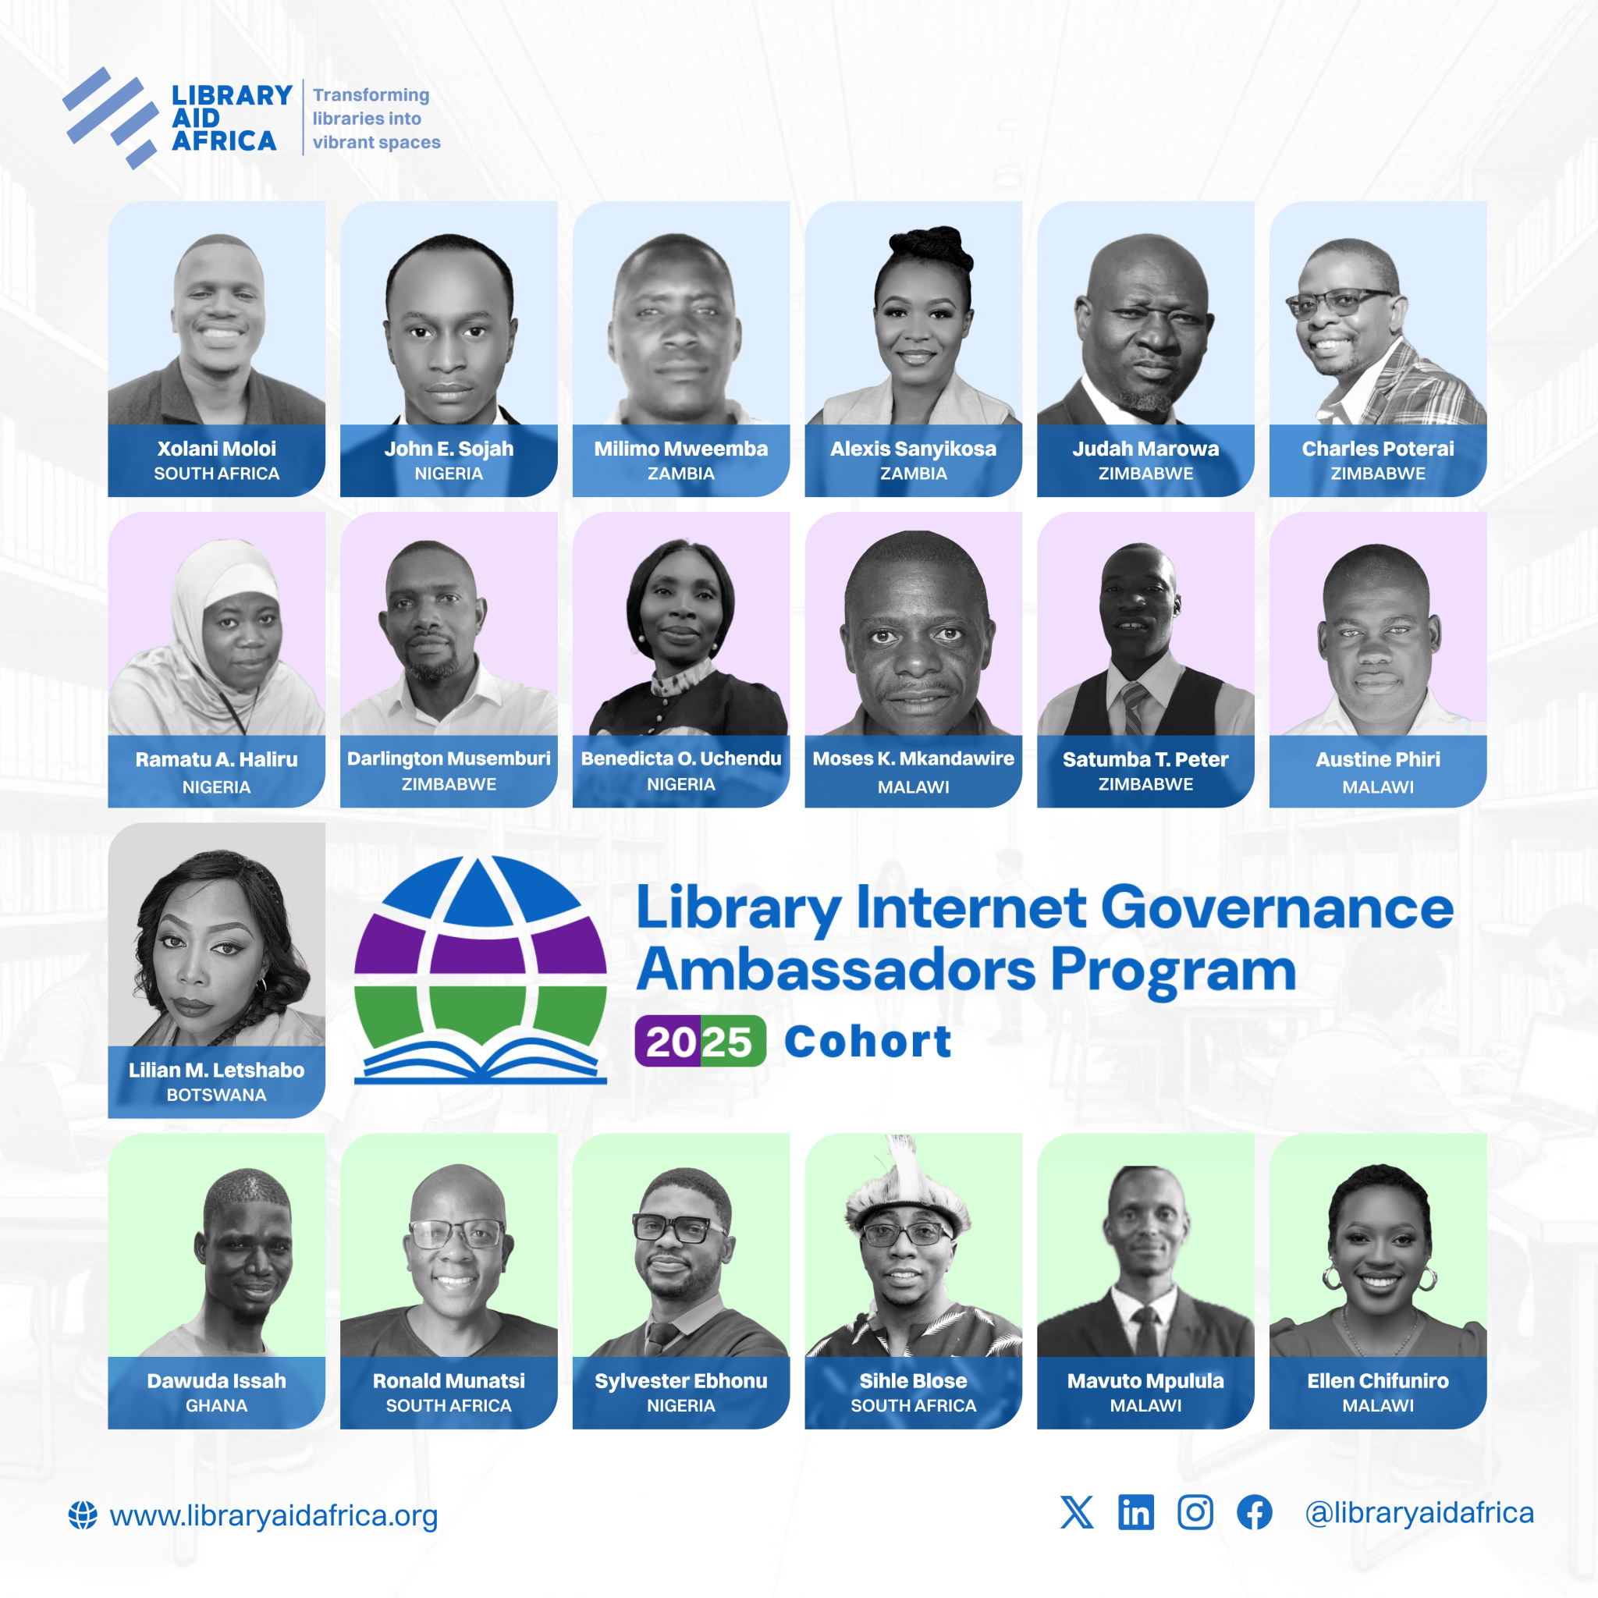
integrate libraries into the discourse and actions of the Internet Governance Forum (IGF) at the national, and regional levels across Africa, ensuring active participation of libraries

Slide 9

Leading Digital Inclusion Efforts on the ground

Slide 10
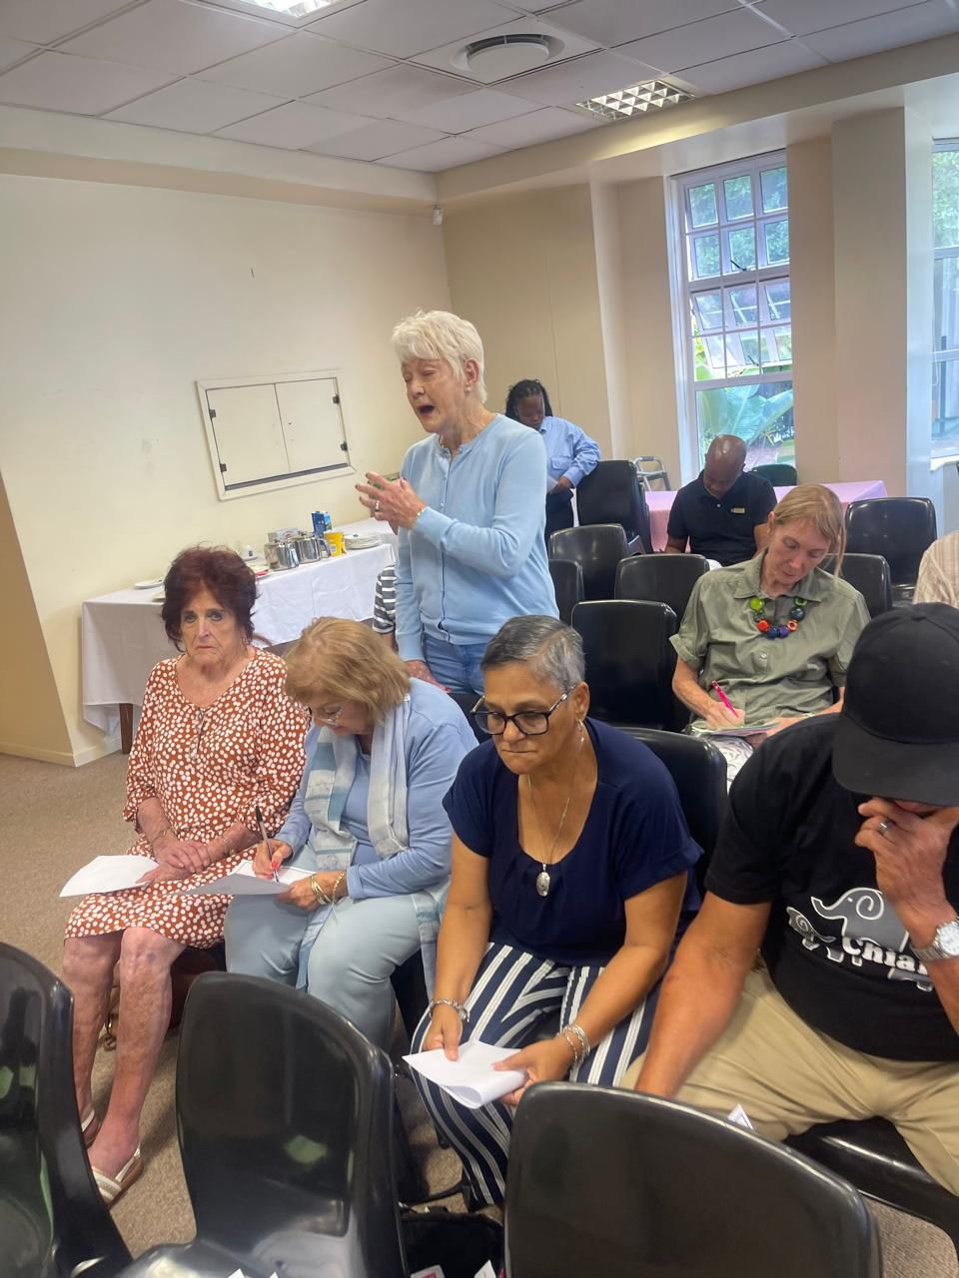
Xolani Moloi
South Africa
The Cyber Zone Project at La Lucia Library
Closing the Digital Gap for Pensioners
Providing them with access to digital literacy skills
lessons on using the internet safely, navigating computers, and accessing digital resources available at the library

Slide 11
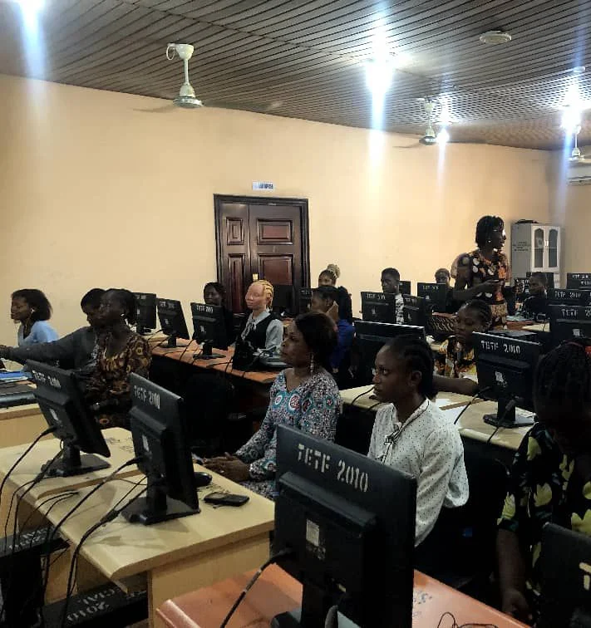
Benedicta Uchendu
Nigeria
Digital Literacy for Librarians: 21st Century Skills for service delivery. Training them on how to use digital tools to transform library services delivery

Slide 12
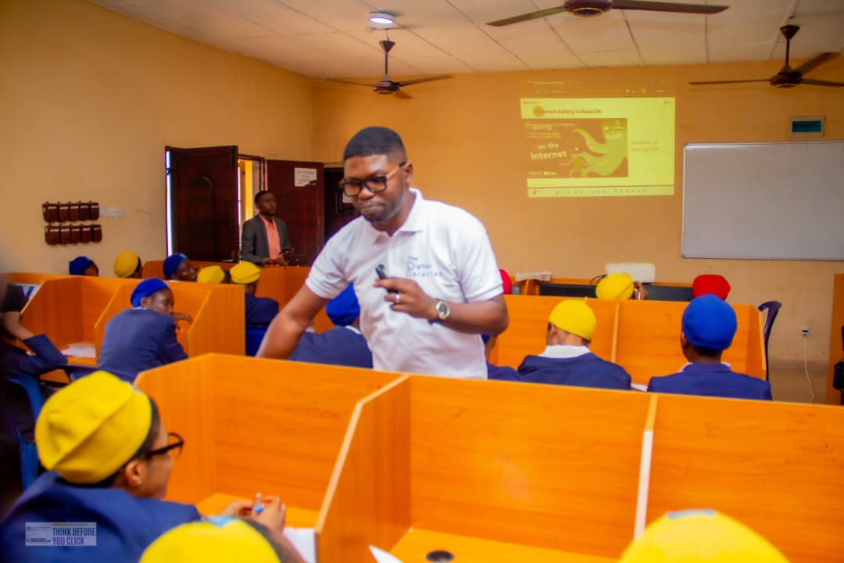
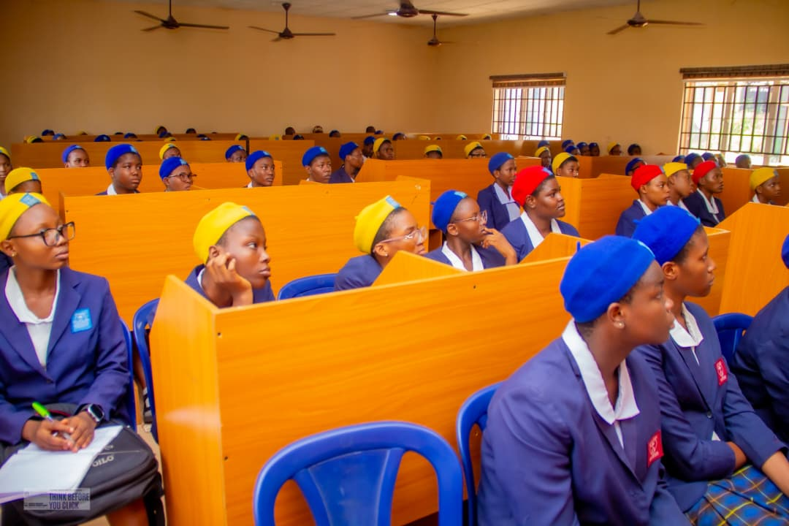
Sylvester Ebhonu
Nigeria
“Think Before You Click” workshop at Federal Government Girls College, training young girls on how to stay safe online

Slide 13

Mobilizing librarians across African countries to lead sessions on the need for LibraryTech skills.

Slide 14
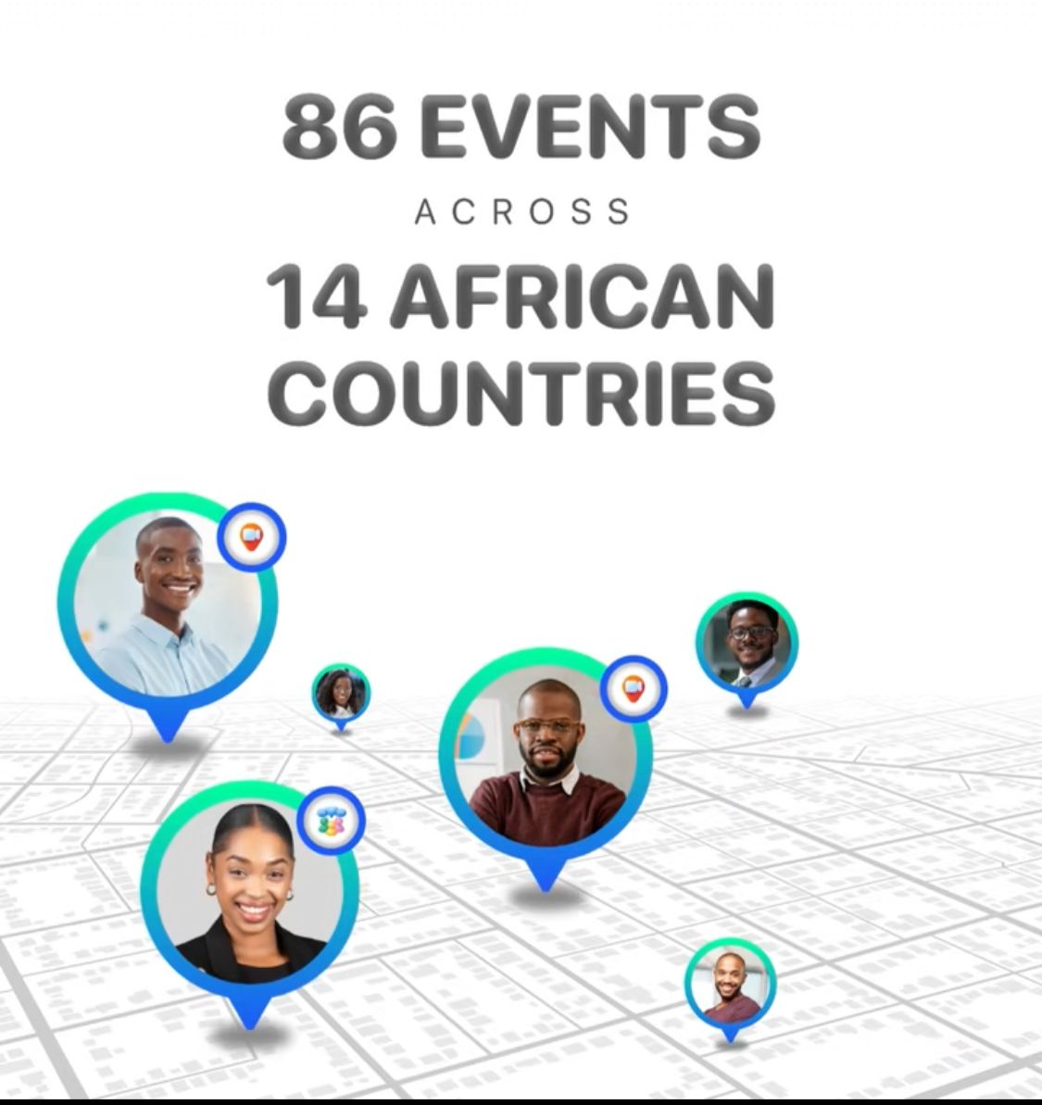
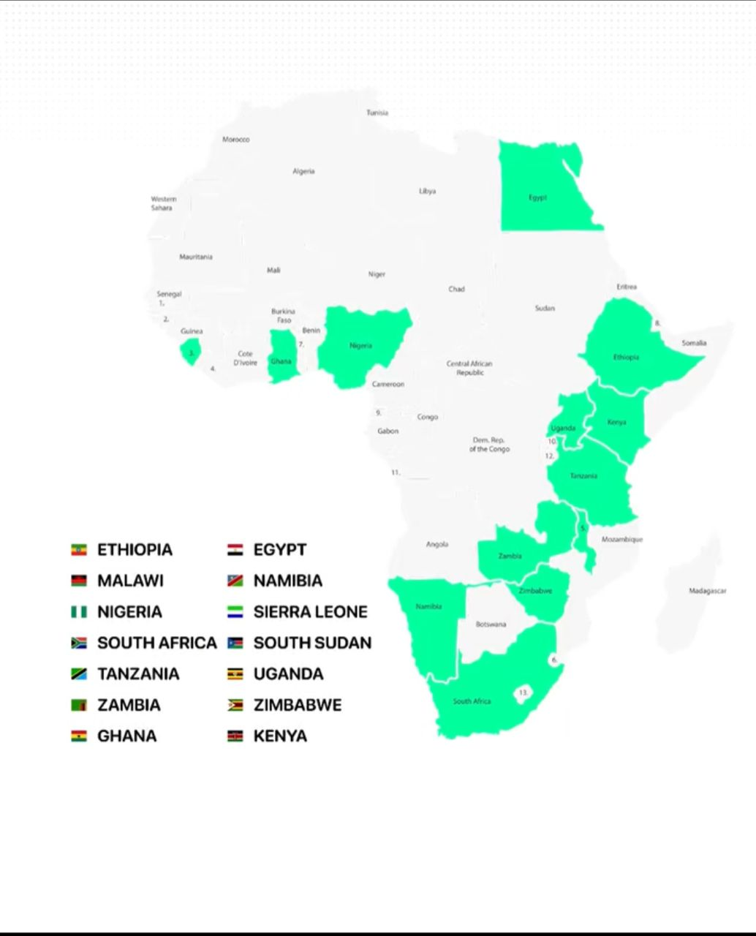

Slide 15
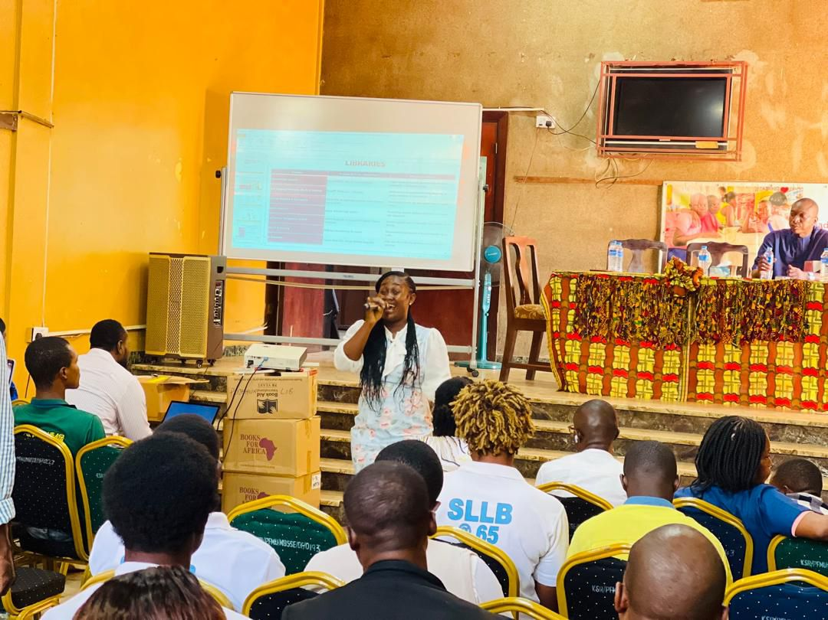
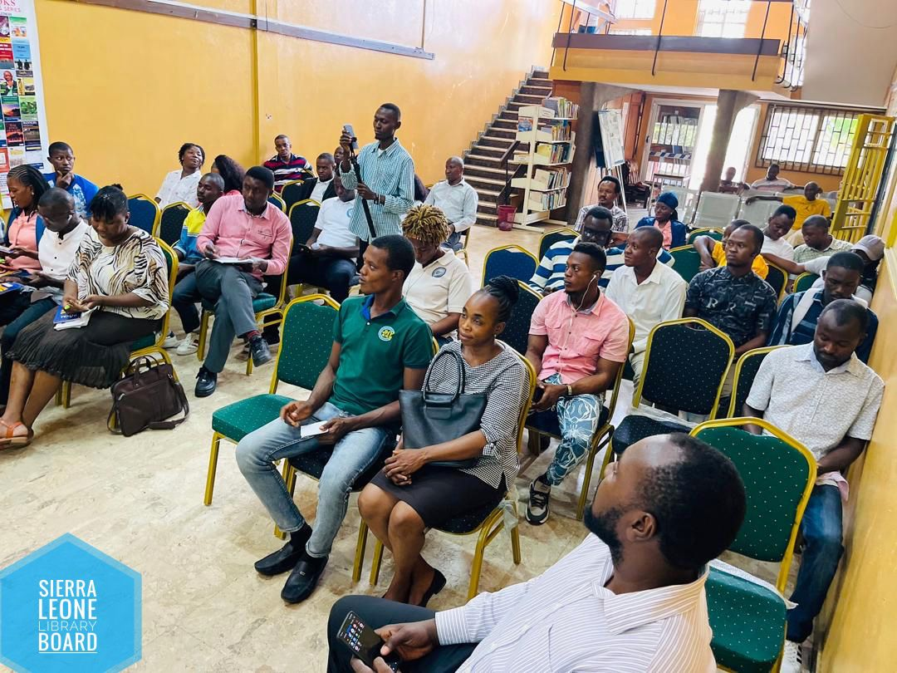
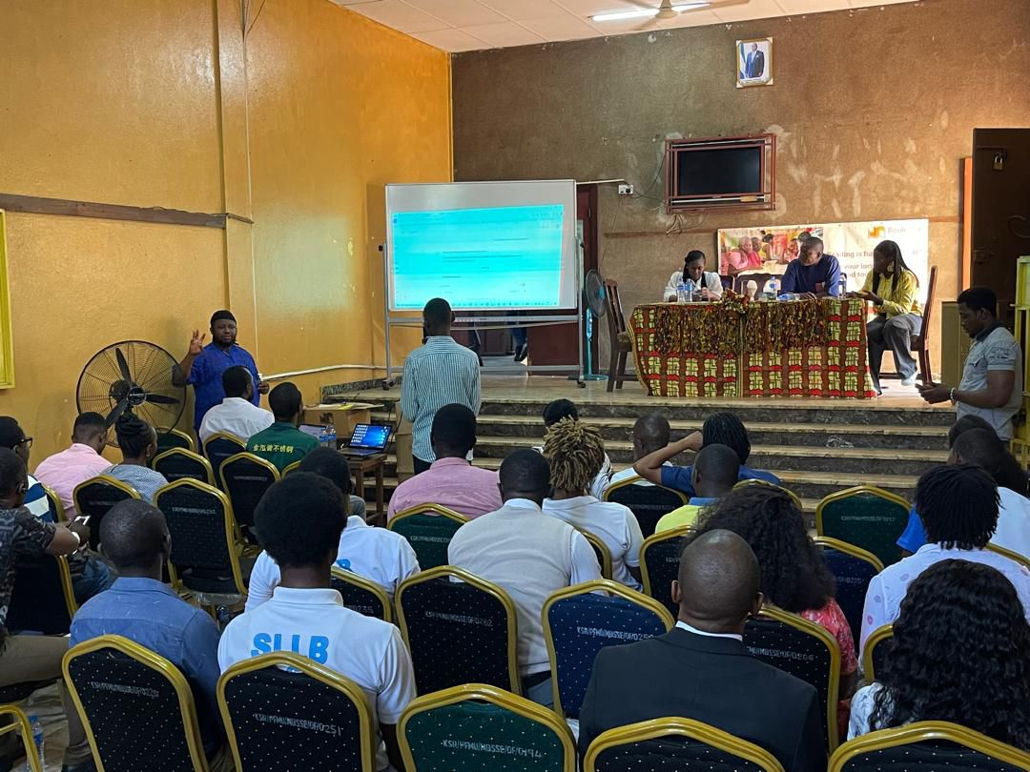
Dunstanette Orehdola Bodkin
Sierra Leone

Slide 16
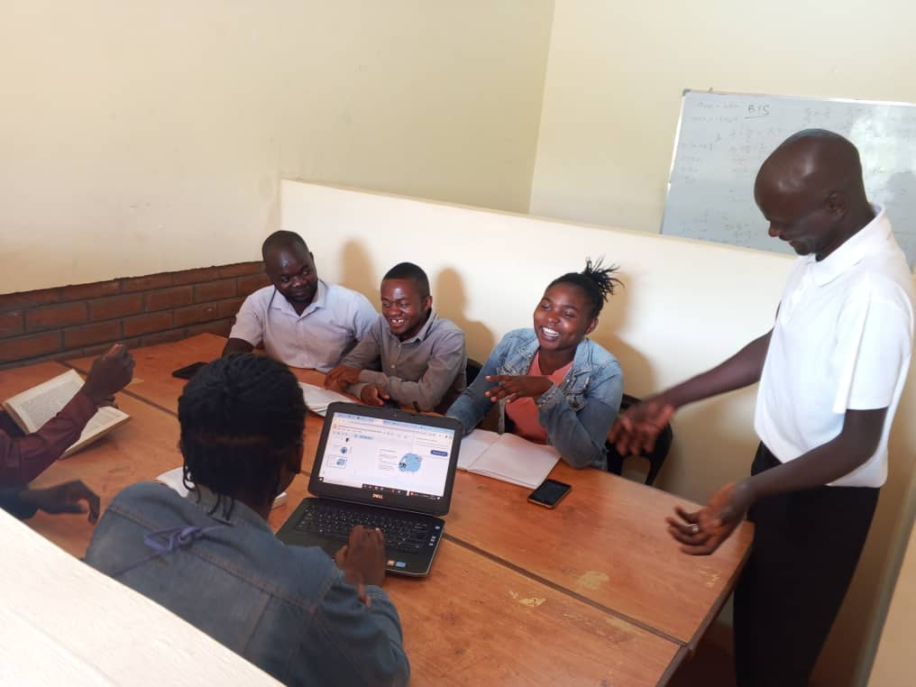
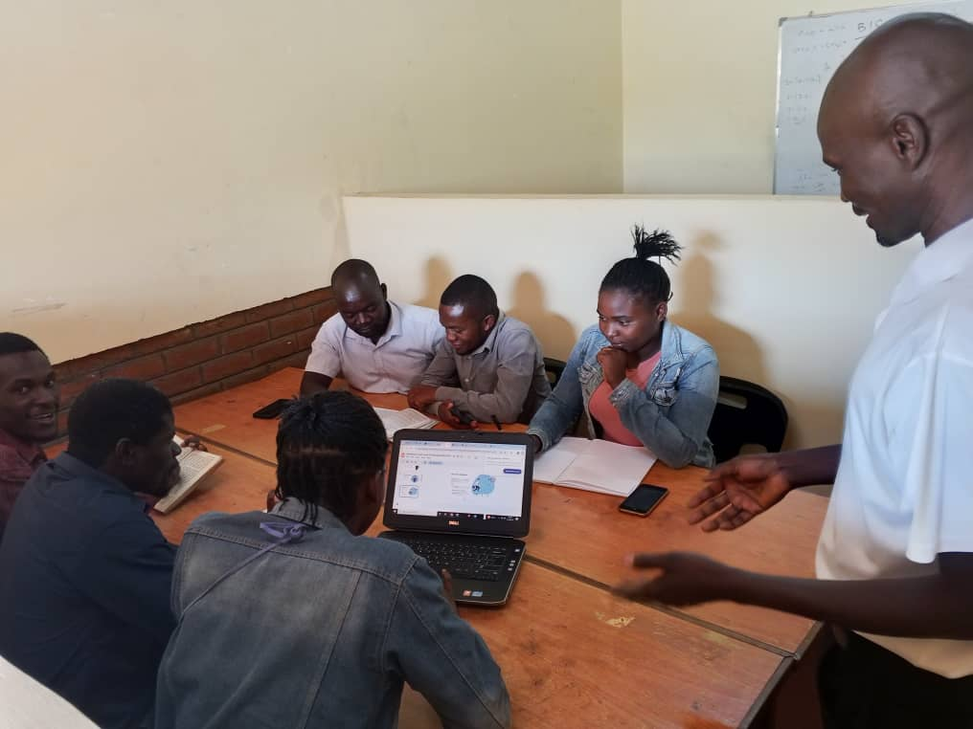
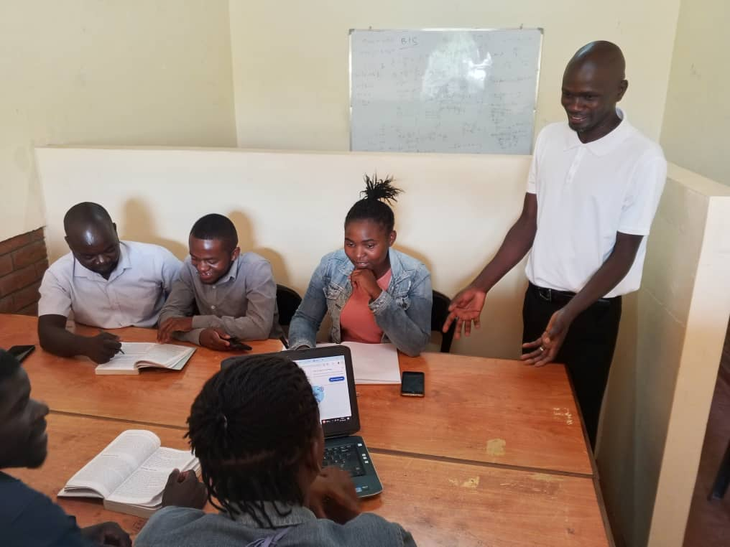
Tayajana Zakaria
Malawi

Slide 17

Build with our Communities

Slide 18





Nurturing the next generation of library leaders in Africa
Capstone Project
Community development through literacy programs

Slide 19


YALLF IMPACT
Trained
Across
Over
4
100
19
50
Cohorts
Young Library Leaders
African Countries
Capstone Project

Slide 20


Slide 21
Collaboration with Library Associations and Institutions

Slide 22
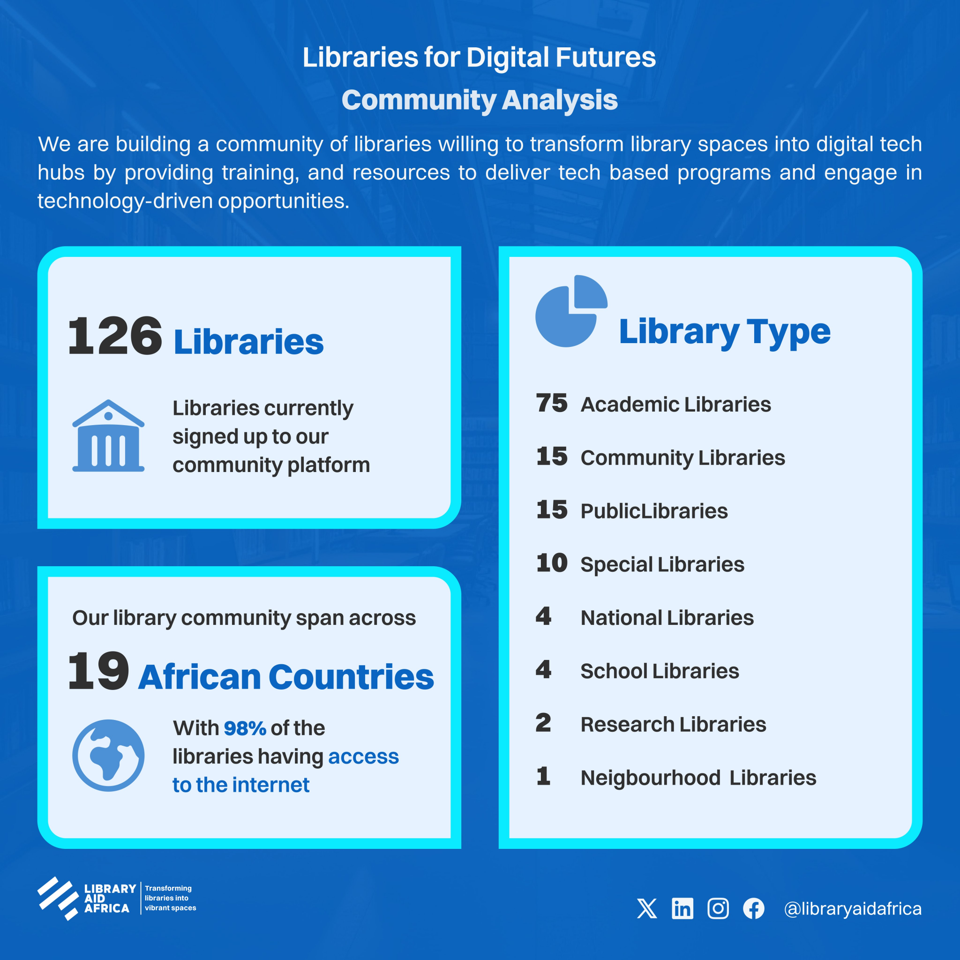
Libraries for Digital Futures

Slide 23

Strengthening Library Systems

Slide 24



Slide 25



Slide 26
Empowering Librarians to Lead Digital Inclusion in Africa: Insights from Library Aid Africa

Slide 27

Empower librarians to build with their communities, collaborate with library institutions and strengthen library systems

Slide 28

Some partners we have worked with on this journey

Slide 29
An African Proverb says,
“
If you want to go fast, go alone. If you want to go far, go together.
“

Slide 30


Join our story at
libraryaidafrica.org

