Slide 1

Social Media Reactions to Sex Toy Criminalization in Ghana: A Cross-Sectional Sentiment and Text Network Analysis
Anthony Senanu Agbeve¹, Daniel Yaw Fiaveh¹, Martina Anto-Ocrah², & Amanda Yad-El Ugboji²
1 University of Cape Coast, Ghana | 2 University of Pittsburgh, USA
2ND INTERNATIONAL CONGRESS
ON AFRICA-SPAIN DIGITAL DIALOGUES
MAY 6 – 8, 2026

Slide 2
1.0
Background & Context
The Digital Paradox
Digital platforms, once celebrated as tools for freedom of expression, have increasingly become instruments of repression and control. Social media now serves as a primary medium for curtailing women's agency, where those who challenge patriarchal norms face systematic ridicule, labeling, and moral policing.
Legislative & Judicial Context
The Minister's Opposition
1
August 2021: "The Promotion of Proper Human Sexual Rights and Ghanaian Family Values Bill" introduced to criminalize LGBTQ+ activities and sex toy use.
"This may create unintended consequences because sexual intercourse with all manner of aids, including sex toys that couples use to enhance their sexual experience..."
2
July 2024: Supreme Court reaffirmed that sex toys remain unlawful under Section 104(1)(b) of the Criminal Offences Act, 1960.
— Ursula Owusu-Ekuful, Former Minister of Communication, December 2023
Her stance sparked heated social media debates with supporters applauding her audacity while opponents accused her of being a practicing member of the queer community.
The Central Argument
This controversy reveals how digital platforms function as tools of repression —where dissenting or progressive positions on women's sexual autonomy are quickly personalized, stigmatized, and subjected to moral policing, reinforcing dominant heteronormative norms and silencing agentic expression.

Slide 3
2.0
Overarching Goal
Primary Research Objective
To explore narratives around sexuality and bodily autonomy, understanding how these discourses shape sexual agency in contemporary Ghana, particularly for women.
2
1
Investigate Public Perceptions
2
Identify Platform Differences
Analyze social media comments to understand public attitudes toward the criminalization of sex toys as expressed across multiple platforms.
1
Determine whether sentiment expression varies across social media platforms—are comments on X more negative compared to Instagram or Facebook?

Slide 4
3.0
Methodology
Data Collection
Data Cleaning
Platforms: Instagram, X, Facebook, YouTube
• Removed duplicates and empty comments
Tool: Python web scraping
• Eliminated stop words (oh, hello, or, is)
Source: Public comments on minister's speech
• Applied lemmatization (NLP preprocessing)
• Removed emojis to prevent misclassification
Three-Step Analytical Process
1
Comparative Analysis
2
Sentiment Analysis
3
Thematic Analysis
Examine platform-specific patterns using conditional probability to identify differences in sentiment expression across Instagram, X, Facebook, and YouTube.
Pipeline method using NLP and machine learning to classify comments as positive, negative, or neutral, revealing dominant emotional responses.
Identify recurring themes in comments to understand public views on sex toy criminalization and how these reflect patriarchal control mechanisms.

Slide 5
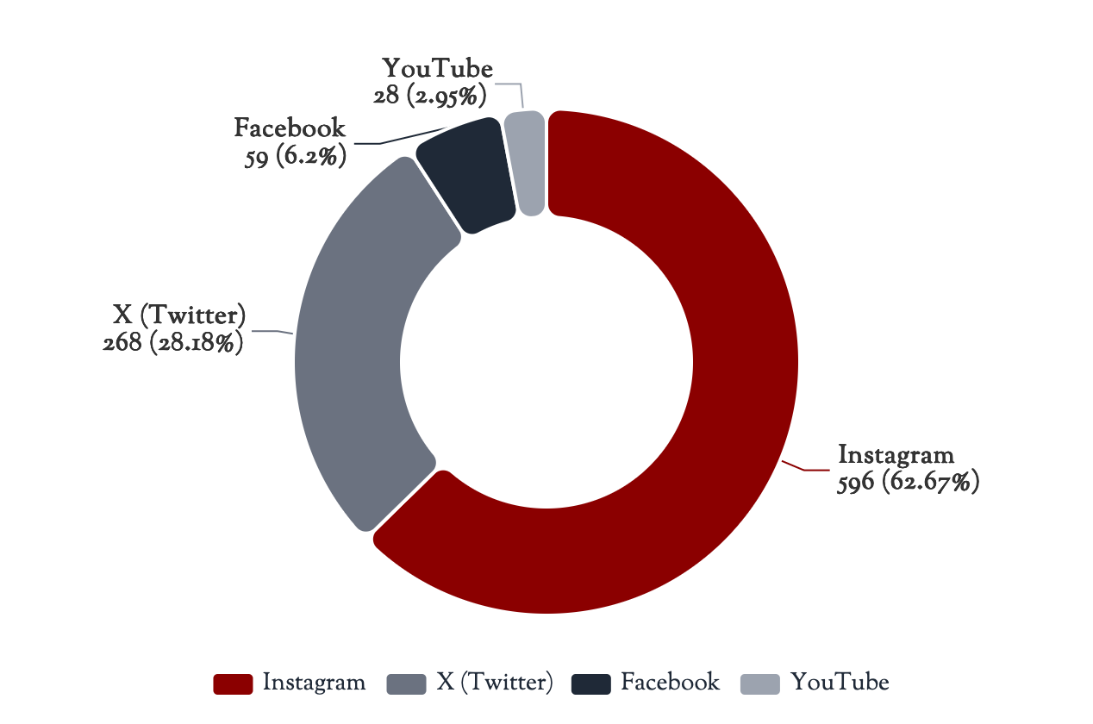
4.0
Data Overview: Comment Distribution
Figure 1: Comment Distribution Across Platforms
Total Comments
951
After data cleaning and preprocessing
Platform Breakdown
Instagram
596
(62.7%)
X (Twitter)
268
(28.2%)
Facebook
59
(6.2%)
YouTube
28
(2.9%)

Slide 6
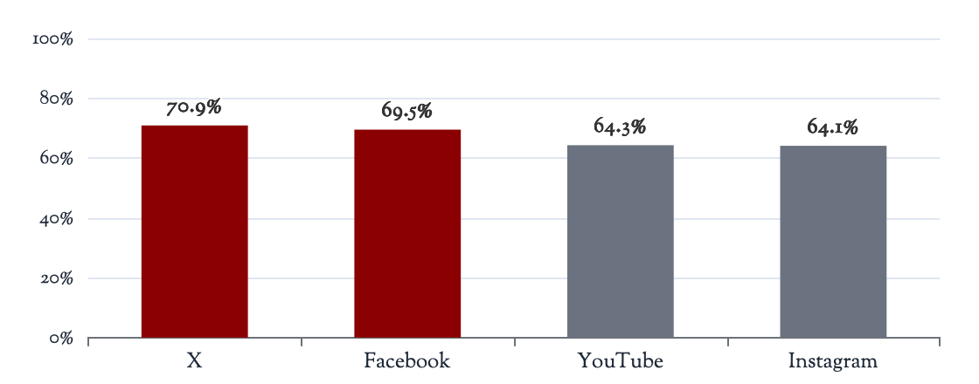
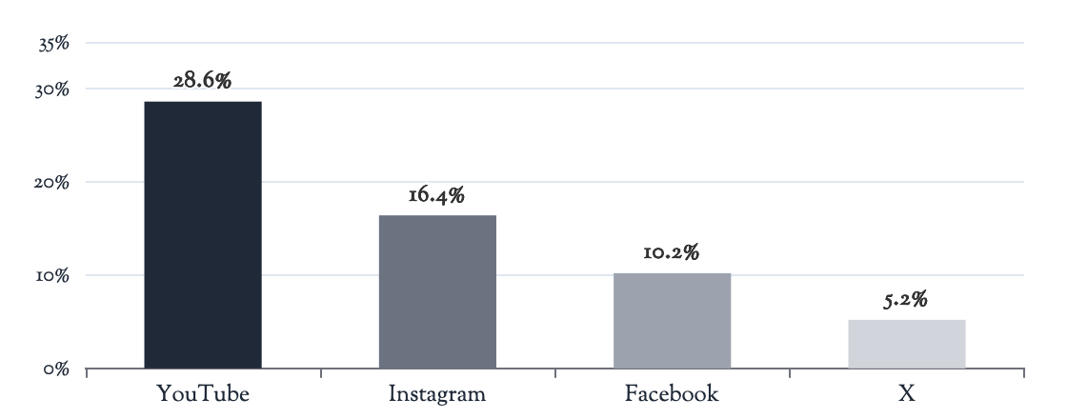
5.0
Platform Comparison
Cross-Platform Sentiment Differences
Negative Sentiment by Platform
Positive Sentiment by Platform
X (Twitter)
Facebook
YouTube
Instagram
Negative: 70.9%
Negative: 69.5%
Negative: 64.3%
Negative: 64.1%
Positive: 5.2%
Positive: 10.2%
Positive: 28.6%
Positive: 16.4%
Neutral: 23.9%
Neutral: 20.3%
Neutral: 7.1%
Neutral: 19.5%
Highest Negativity
Most Positive Platform
Chi-square test showed a statistically significant association (p<0.001) between sentiment scores and data source, confirming platform-specific differences in sentiment expression.
X (Twitter) shows the highest proportion of negative sentiment (70.9%) , followed by Facebook (69.5%), suggesting these platforms may amplify polarizing discourse.
YouTube has the highest positive sentiment (28.6%) , more than 5x higher than X (5.2%), indicating different user demographics or discussion contexts.

Slide 7
6.0
Sentiment Analysis Results
Overall Sentiment Distribution and Keyword Analysis
Negative
Neutral
Positive
66.35%
20.40%
13.25%
631 comments
194 comments
126 comments
Negative Sentiment Keywords
Positive Sentiment Keywords
lesbian
disgrace
disgusting
freaky
stupid
useless
foolish
gay
joy
love
better
enjoy
rights
support
Example Comments:
Example Comments:
“She was a lesbian all through secondary school. I am not surprised. That's why she doesn't respect men…"
“Sex toys do not kill... they always bring joy to women who do not have boyfriends."
“Men can do the work, but she is here talking about sex toys. She is a disgrace to the Ghanaian culture."
“I support her on this because sex toys are for general use and not limited to only gays."
Neutral Sentiment Keywords
harm
pressing issues
personal choices
Example Comments:
“So far as it doesn't harm anyone, why the need for such laws?"
“There are more pressing issues in this country than debating sex toys."

Slide 8
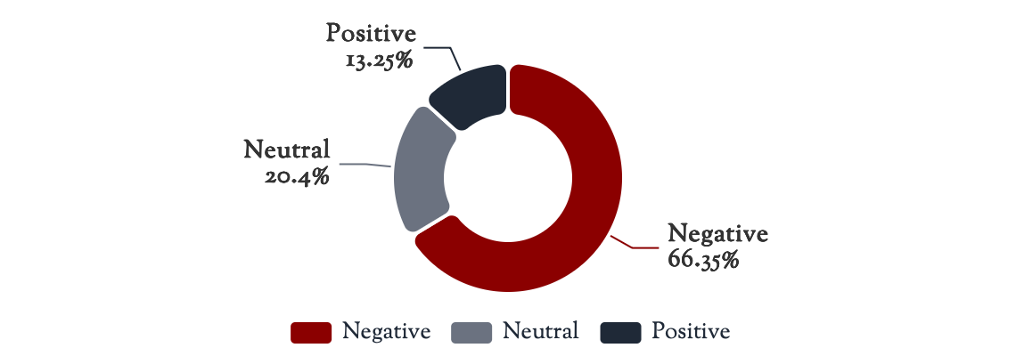
6.0
Sentiment Analysis Results
Figure 4: Overall Sentiment Distribution
Dominant Sentiment Categories
Moral Outrage
45%
Expressions of disgust, religious condemnation, calls for punishment
“This woman is a disgrace to Ghana. How can she promote such immorality in parliament?"
Ridicule and Mockery
30%
Dismissive attitudes, personal attacks, sexualized insults
“What are you going to use the sex toys for?" — Radio presenter questioning Ursula
Key Insight
Fear and Anxiety
15%
Concerns about moral decay, threats to family structures
The intensity of backlash demonstrates that the debate touched on deeply contested terrain where traditional norms are being actively challenged. The 10% progressive voices, while small, represent a significant shift in public discourse.
“If we don't stop this, our children will think this is normal. Ghana is losing its values."
Supportive/Progressive
10%
Feminist advocacy, human rights arguments, calls for sexual autonomy.
“Women have the right to pleasure too. This bill affects all of us, not just LGBTQ."

Slide 9
7.0
Key Themes & Discussion
1
Sexist Undertones: Targeting Women's Sexual Autonomy
Beyond general resistance to non-normative sexualities, negative sentiments revealed sexist undertones, targeting women who expressed or supported sexual autonomy. Women were labeled simply for acknowledging the right to sexual agency.
Derogatory Labels Applied
Mechanisms of Control
Immoral
Deviant
"Loose"
Freaky
Disgrace
• Limit women's bodily autonomy
• Deny women's right to pleasure
• Maintain male dominance in sexual decision-making
2
Sex Toys as Symbolic Threats to Heteronormative Order
Sex toys were not viewed as legitimate pleasure-enhancing tools but as symbolic threats to the socially and religiously prescribed heteronormative order. Their connection to alternative sexual practices elicits strong resistance rooted in:
Entrenched Gender Norms
Conservative Religious Teachings
Moral Expectations
Reproduction as primary purpose; male-dominated intimacy
Christianity and Islam uphold conservative views condemning non-heteronormative sexualities
Sexual expressions outside reproduction framed as immoral or unnatural

Slide 10
7.1
Key Themes & Discussion
3
Male-Centered Sexual Framework and Devaluation of Female Pleasure
Comments such as “men can do the work" reflect deeply entrenched cultural beliefs that prioritize male sexual performance while relegating women's sexual needs as secondary or unnecessary.
Systemic Impacts
Critical Questions
Restricted Autonomy: Women's capacity to explore preferences is limited
“Are women only expected to participate in sex for reproduction or to satisfy men?"
Undermined Rights: Legitimacy of women's sexual rights eroded
“Is sexual pleasure viewed as primarily for men?"
Power Imbalances: Male-centered authority perpetuates inequality
4
Suppression of Women's Sexual Needs Within Patriarchal Structures
The negative reactions underscore how women's sexual needs are routinely suppressed within patriarchal societies. Women advocating sexual rights are perceived as threats to masculine order.
Derogatory Labeling as Control
Ideological Tools of Control
Labels like "freaky," "disgrace," and "lesbian" serve multiple functions: delegitimizing women's sexual preferences, exposing women to verbal abuse and social ostracism, creating deterrence against future advocacy, and reinforcing that female sexual agency must be controlled.
These derogatory terms become ideological tools of control aimed at delegitimizing women's voices and reinforcing patriarchal dominance over sexual discourse and practice. The backlash reveals societal mechanisms used to discipline and silence assertive individuals.

Slide 11
8.0
Conclusion: Digital Platforms as Tools of Sexual Policing
The Repressive Turn of Digital Spaces
Social media and digital platforms have become sources of policing on women's sexual agency—transforming from celebrated tools of freedom into active mechanisms of patriarchal control and moral surveillance.
How Digital Platforms Enable Repression
Hindering Women's Sexual Rights and Agency
1. Amplification of Moral Outrage: Platforms like X and Facebook amplify polarizing discourse, with negativity reaching 70.9% and 69.5% respectively.
• Deterrence Effect: The labeling and shaming of women who assert sexual agency serves as a powerful deterrent, discouraging other women from claiming their sexual rights.
2. Systematic Ridicule and Labeling: Women challenging norms face coordinated attacks, with 30% of discourse consisting of ridicule and mockery.
• Normalized Surveillance: Digital platforms enable constant monitoring and policing of women's sexual expression, making privacy and autonomy increasingly difficult.
3. Hostile Environment Creation: Digital spaces become unsafe for women to express their agentic sexual needs, with 66.35% of overall sentiment being negative.
• Reinforced Patriarchy: The backlash reveals not cultural values but active mechanisms that maintain male sexual dominance and suppress female agency.
“The intensity of digital backlash against women's sexual autonomy demonstrates that these platforms have become contested terrains where patriarchal norms are not merely expressed but actively enforced through coordinated moral policing, ridicule, and systematic silencing. This digital repression fundamentally hinders women's ability to claim sexual rights and exercise agency in both online and offline spaces."

Slide 12
Thank You
Contact Information
Corresponding Author: Anthony Senanu Agbeve
Email: anthony.agbeve@stu.ucc.edu.gh
Phone: +233240217647
Acknowledgment
Nabeeha Affan for initial literature review

